Slide 1
Air Plan:
Issues and Options Workshop
Policy
13 December 2023

Slide 2
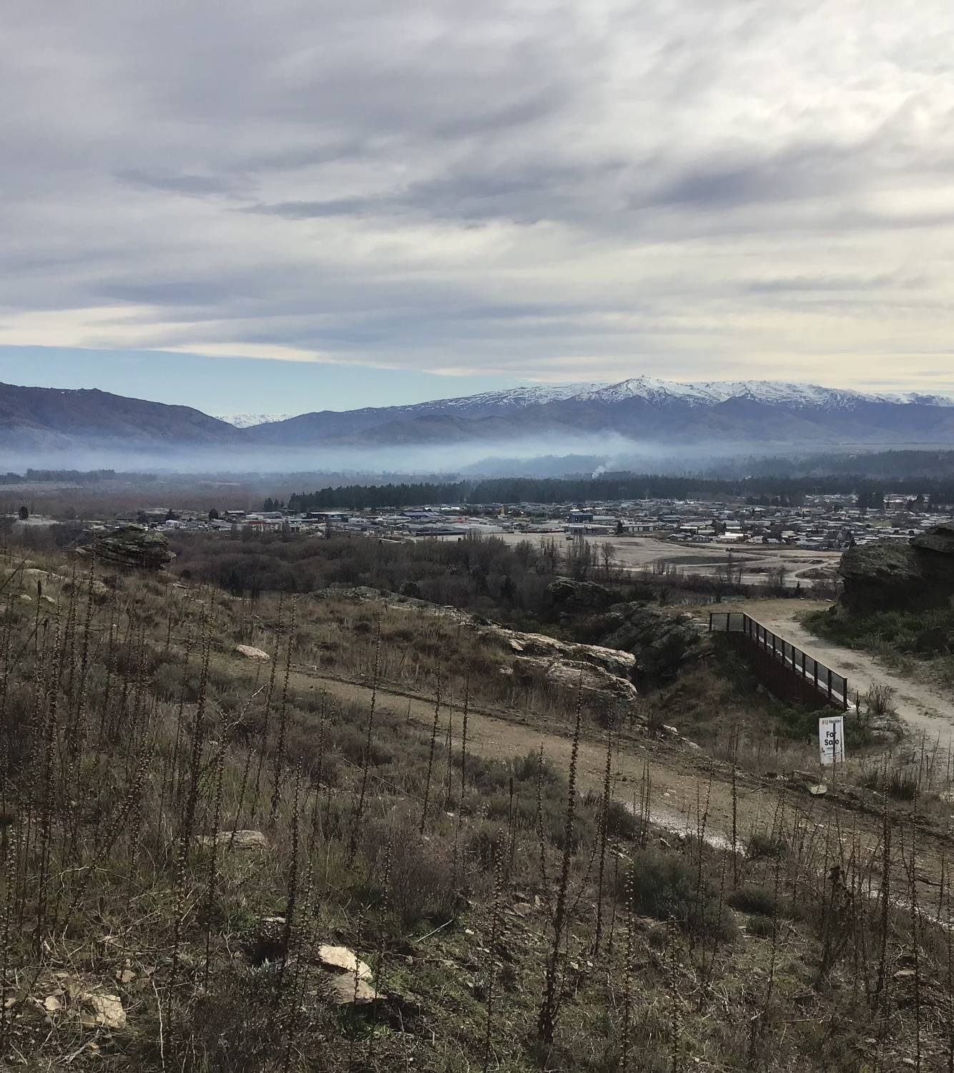
What we will cover today:
Proposed issues for Air Plan engagement
Proposed options for Air Plan engagement

Slide 3
Today’s session plan
Building on the discussion at the committee workshop in September 2023…
Aim:
Establish a set of issues and options the committee is happy for staff to take through to the Air Plan review’s engagement phase.
Approach:
Issue by issue discussion
Options are not exclusive (except the status quo)
Are there any options or issues you think are missing?

Slide 4
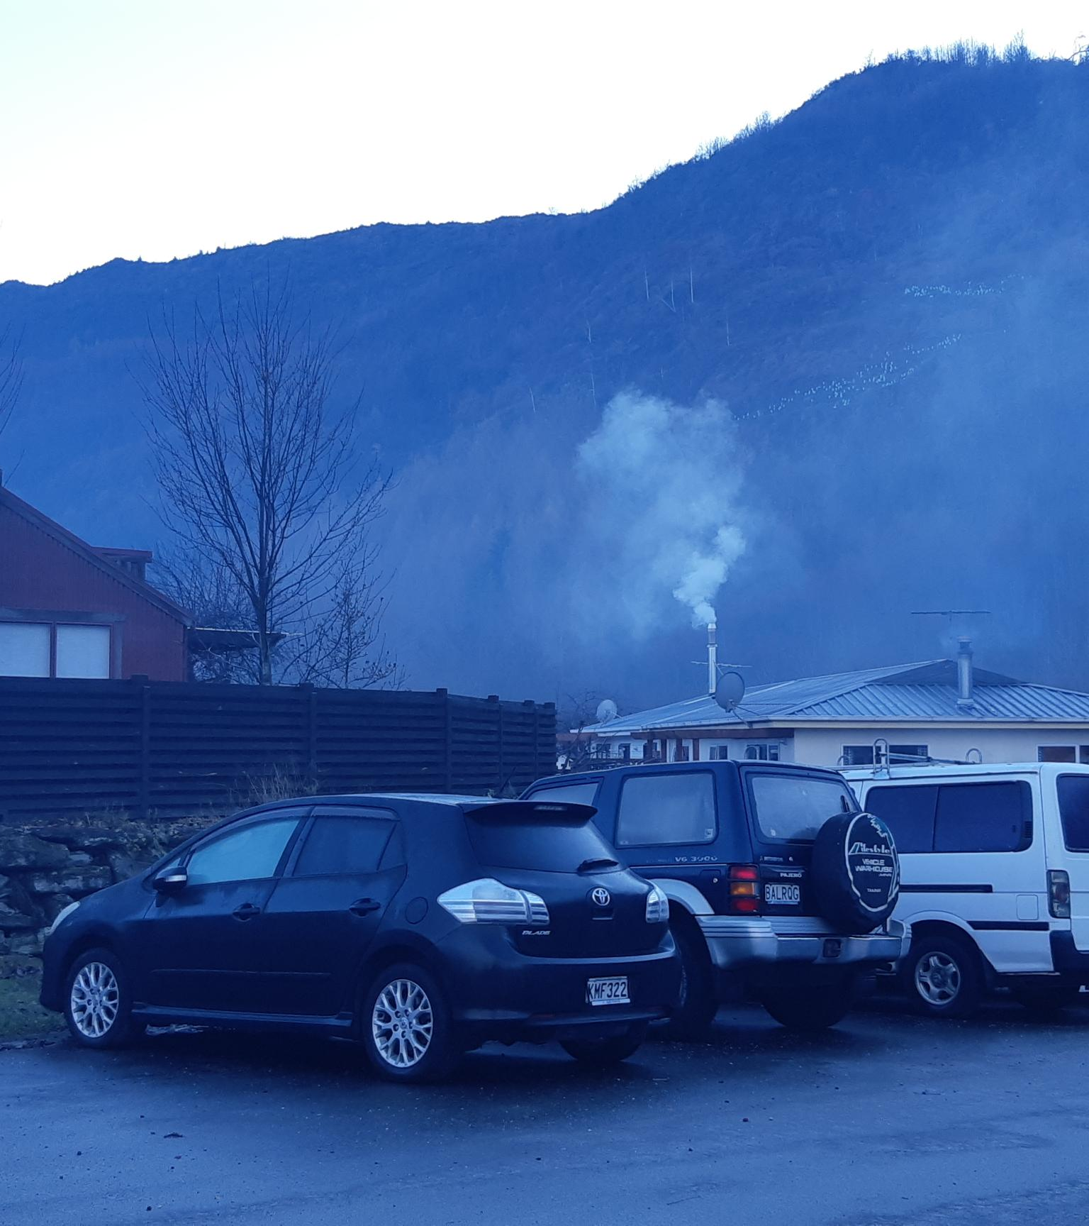
Issues
What are we looking to address?
Domestic heating
Outdoor burning
Vehicle emissions
Discharges from industrial and trade premises
Odour
Dust
Agrichemicals

Slide 5
Domestic heating

Slide 6
The issue
Domestic Heating
Solid fuel burners are the main source of air pollution in urban areas. Exposure to harmful emissions produced by solid fuel burners causes harm to human health and has been found to contribute to premature deaths.
Factor 1.1:
Technology of Burner
Factor 1.2:
Operation of Burners
Factor 1.3:
Costs
Factor 1.4:
Weather conditions
Factor 1.5:
Air Plan Rules

Slide 7
Options
What could we do about it?
Option 1A: Status Quo: Domestic Heating Appliances in ‘Zone 1’ towns must meet the ULEB criteria
Option 1B: New installations of solid fuel burners must meet ULEB standards
Option 1C: Phase out Non- Ultra Low Emission Burners
Option 1D: No new installations of burners in new dwellings or existing dwellings using other heating methods
Option 1E: Phase out all solid fuel burners
Option 1F: Non-regulatory Options: Behaviour change campaign

Slide 8
Outdoor burning

Slide 9
The issue
Outdoor burning
From small-scale practices like bonfires to large-scale rural activities like tussock burn-offs, outdoor burning can cause adverse effects beyond the property boundary, including smoke, odour, ash deposit, and discharges that may be noxious or dangerous. Outdoor burning generates a third of complaints to the pollution hotline.
Factor 2.1:
Materials burnt
Factor 2.2:
Weather conditions
Factor 2.3:
Proximity to residential properties
Factor 2.4:
Air Plan Rules
Factor 2.5: Enforcement
Factor 2.6:
Disposal of waste material

Slide 10
Options
What could we do about it?
Option 2A: Status Quo
Option 2B: Ban outdoor burning over the winter months
Option 2C: Require smoke management plans for large-scale / long-lasting outdoor burning events
Option 2D: Ban outdoor burning on properties less than 2 hectares
Option 2E: Require alternatives to burning
Option 2F: Non-regulatory Options: education campaigns, enforcement and district and city council partnership.

Slide 11
Vehicle emissions

Slide 12
The issue
Vehicle emissions
ORC is limited in what it can do to regulate vehicle emissions through the Air Plan. However, ORC does have scope to implement non-regulatory approaches, and exert influence through the Otago-Southland Regional Land Transport Plan, Otago Regional Public Transport Plan, the Climate Strategy, and the Air Quality Strategy.
Factor 3.1:
Lack of public knowledge
Factor 3.2:
Alternatives to private road transport
Factor 3.3:
Type of vehicle
Factor 3.4:
Urban environment

Slide 13
Options
What could we do about it?
Option 3A: Status Quo
Option 3B: New Air Plan rules and policies
Option 3C: Ensure reliability, availability and safety of public transport
Option 3D: Vehicle decarbonisation
Option 3E: Education / behaviour change campaign
Option 3F: Work with TAs and other authorities

Slide 14
Discharges from industrial and trade premises

Slide 15
The issue
Discharges from industrial and trade premises
In urban areas, industry is the source of 16% of nitrous oxides and 3% of particulate matter emissions. Emissions may include a range of pollutants, including odour and dust.
Contributing Factor:
Consent conditions
Contributing Factor:
Permitted activity rules
Contributing Factor:
Industrial best practice
Contributing Factor:
Land use planning

Slide 16
Options
What could we do about it?
Option 4A: Strengthening existing rules for industrial and trade premises
Option 4B: New Rule to require Best Practicable Option
Option 4C: Buffer Zones

Slide 17
Odour

Slide 18
The issue
Odour
A variety of different activities can give rise to odour emissions. Odour can cause a nuisance and affect amenity. Odour generates 33% of complaints to the pollution hotline
Contributing Factor:
Variety of sources
Contributing Factor:
Consent conditions
Contributing Factor:
Difficulty in investigation
Contributing Factor:
Use of best practice
Contributing Factor:
Land use planning

Slide 19
Options
What could we do about it?
Option 4A: Strengthening existing rules for industrial and trade premises
Option 4B: New Rule to require Best Practicable Option
Option 4C: Buffer Zones
Option 4D: New Rules to require Dust and Odour Management Plans
Option 4E: Include more information about FIDOL assessments

Slide 20
Dust

Slide 21
The issue
Dust
Dust can arise from various sources and, depending on its provenance, can create a range of adverse effects. Responsibilities for managing dust are shared between regional and territorial authorities.
Contributing Factor:
Range of sources
Contributing Factor:
Weather conditions
Contributing Factor:
Difficult to contain
Contributing Factor:
Cost of long-term solutions
Contributing Factor:
Land use planning

Slide 22
Options
What could we do about it?
Option 4A: Strengthening existing rules for industrial and trade premises
Option 4B: New Rule to require Best Practicable Option
Option 4C: Buffer Zones
Option 4D: New Rules to require Dust and Odour Management Plans
Option 4E: Include more information about FIDOL assessments

Slide 23
Agrichemicals

Slide 24
The issue
Agrichemicals
Agrichemicals and the risks they can present are subject to national legislation and codes of practice. Adverse effects of spraying can occur when the spray drifts onto non-target areas and onto neighbouring properties. Any rules for agrichemical use in the Air Plan should support rules being considered for the draft LWRP
Contributing Factor:
Weather conditions
Contributing Factor:
Industrial best practice
Contributing Factor:
Land use planning

Slide 25
Options
What could we do about it?
Option 4F: Strengthening existing rules for agrichemical spraying, include a requirement to notify the council and affected properties

Slide 26
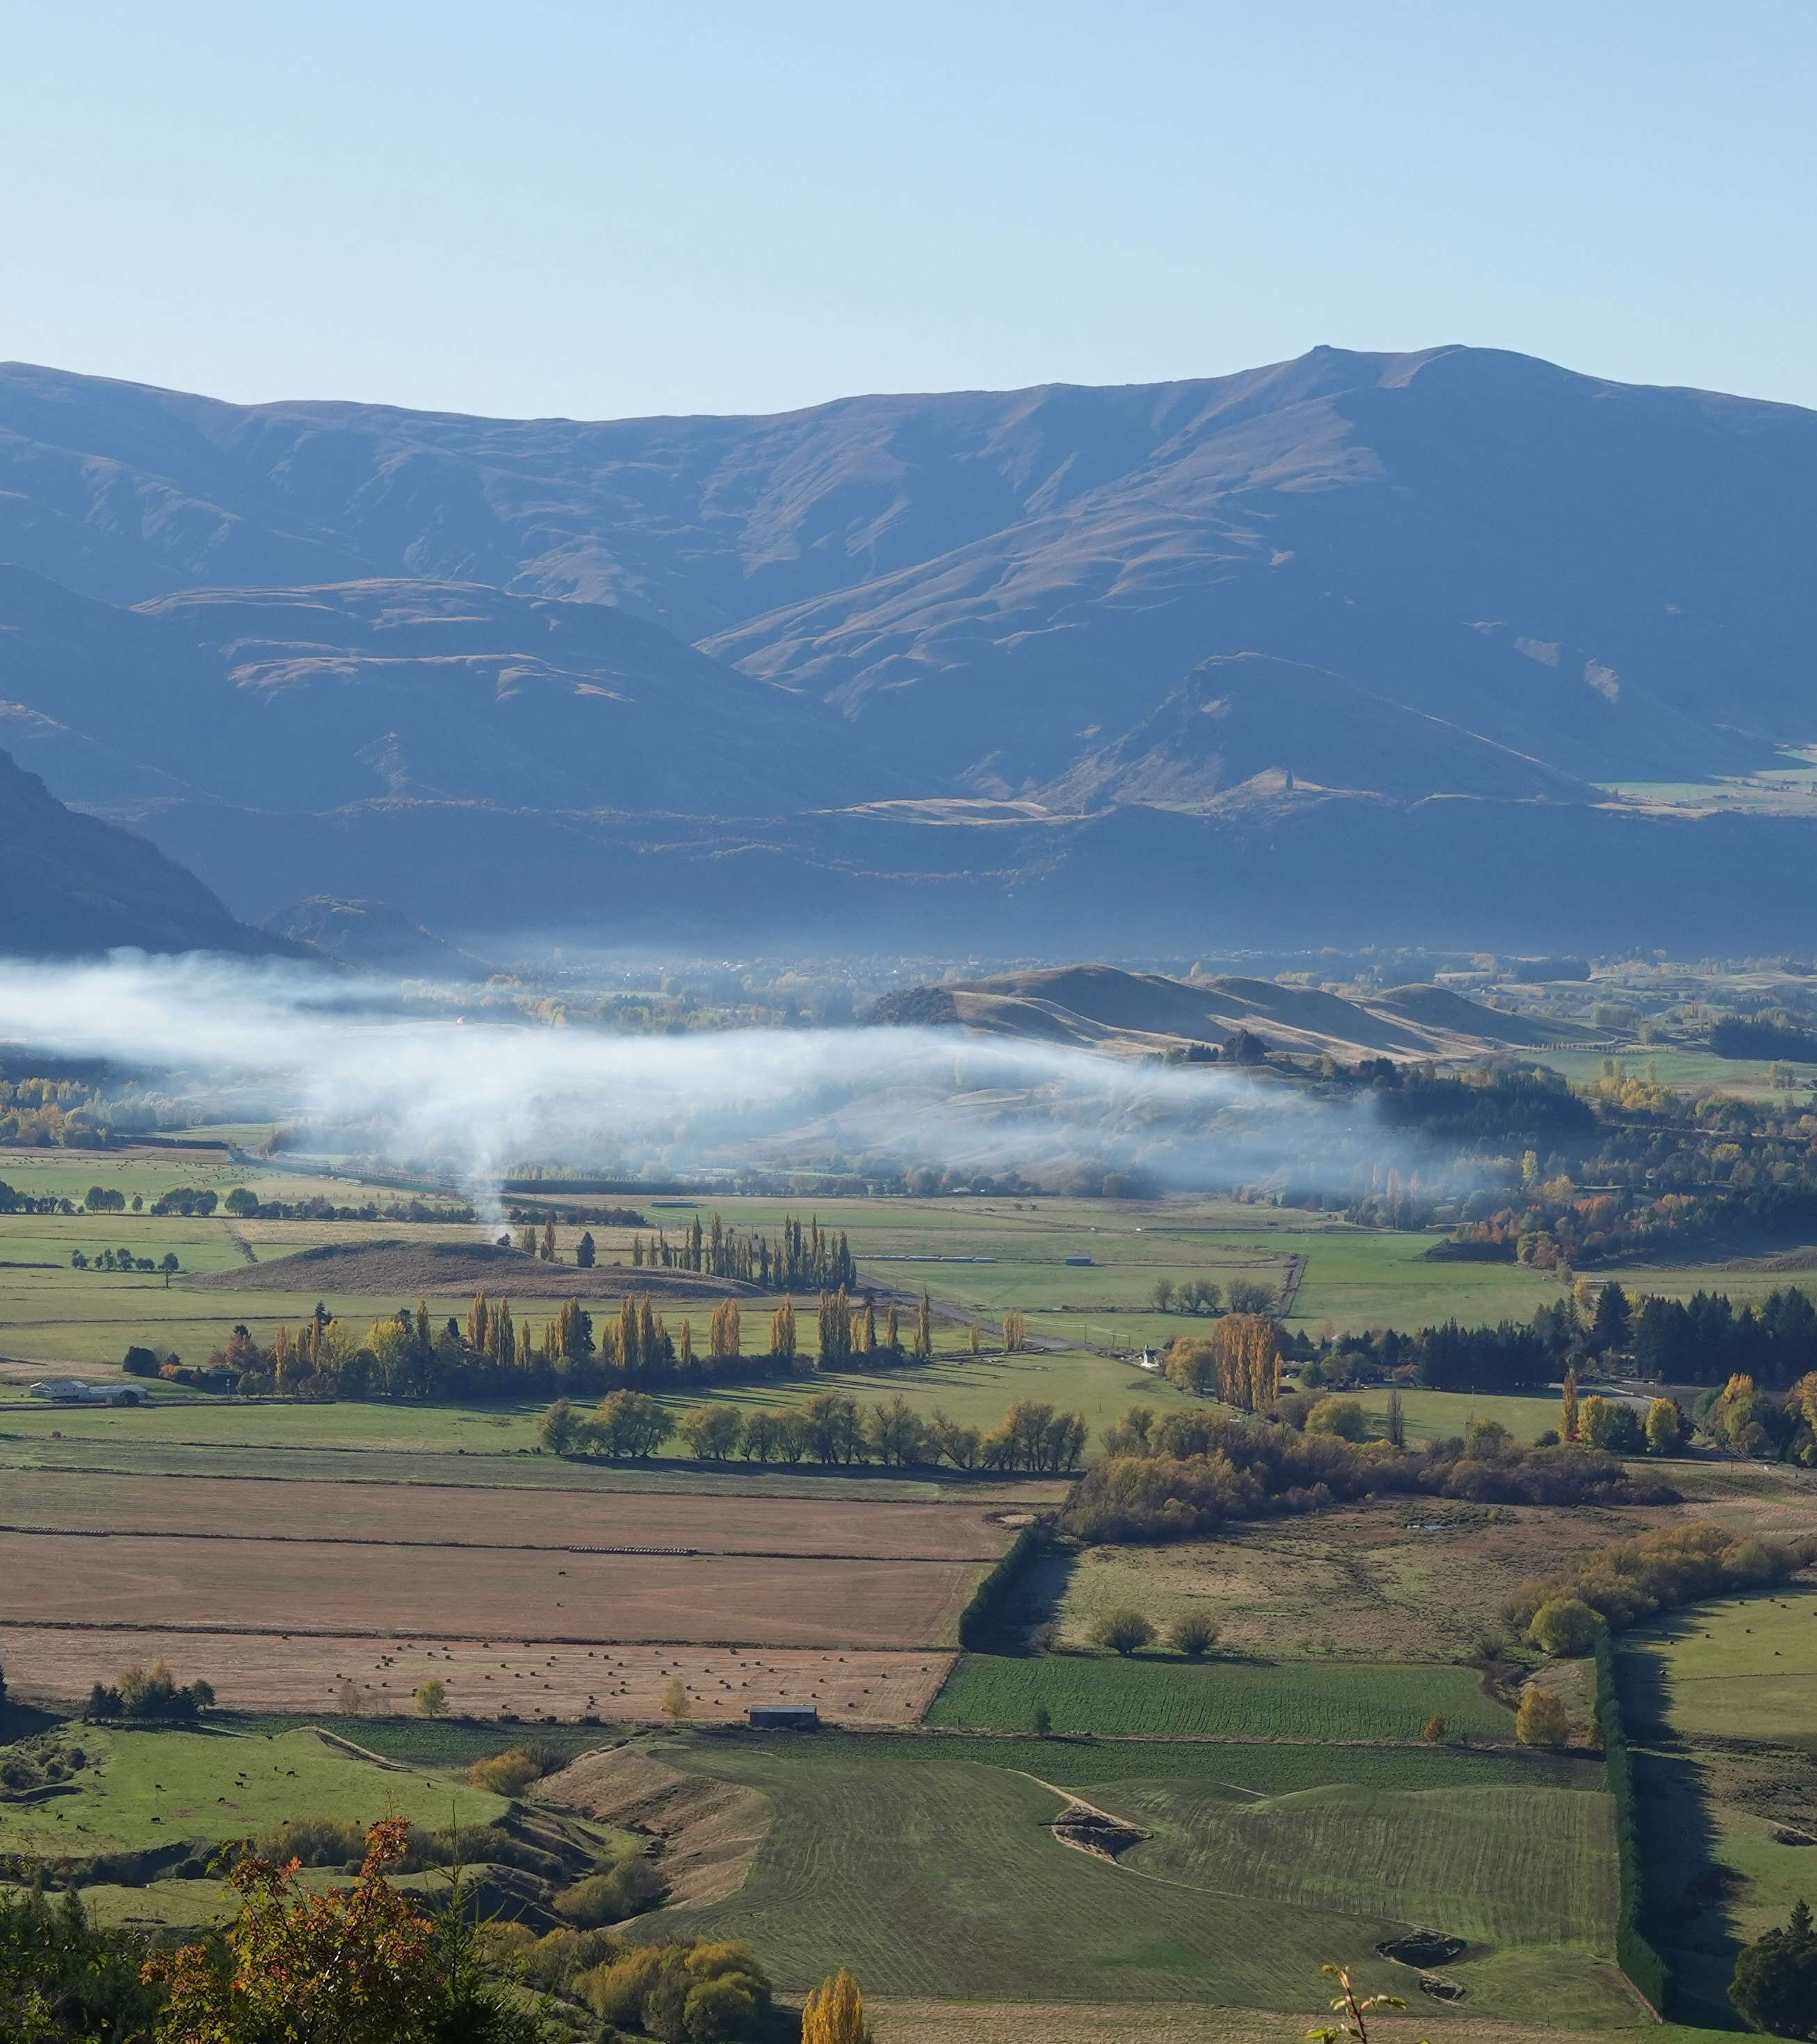
Any other issues?
We have covered:
Domestic heating
Outdoor burning
Vehicle emissions
Discharges from industrial and trade premises
Odour
Dust
Agrichemicals

Slide 27
Next Steps
Where to from here?
Pending Committee confirmation, the Air Plan review will progress to phase 2: engagement. Phase 2 includes:
Developing the engagement strategy and accompanying materials
External discussions and feedback on the confirmed issues and options
Accompanying communications plan
Airshed boundaries review
Parallel development of the s32 report and options analysis

Slide 28
Next Steps
Where to from here?
Following engagement, the output for phase 2 is a final list of issues and options to inform drafting Air Plan provisions.
Staff will provide an update on progress in the new year before the engagement programme begins.
Timing of engagement will need to be considered in light of LTP, Climate Strategy and LWRP consultations.

