Slide 1
Waiora Manuherekia DECEMBER 2024 UPDATE

Slide 2

Background
Living Manuherekia
Governance Group representing community, iwi and regulatory authorities
$1.9M confirmed 1 July 2024 – 12 month period only. All activities must be completed by 30 June 2025.
Contract for this project is with MCG
Governance Group includes Cr Kevin Malcolm and Richard Saunders
Notes:
Ministry for the Environment work on At Risk Catchments
Initiated an Integrated Catchment Management Plan process – named Living Manuherekia
Governance Group distilled the actions into priorities and then ranked for funding

Slide 3
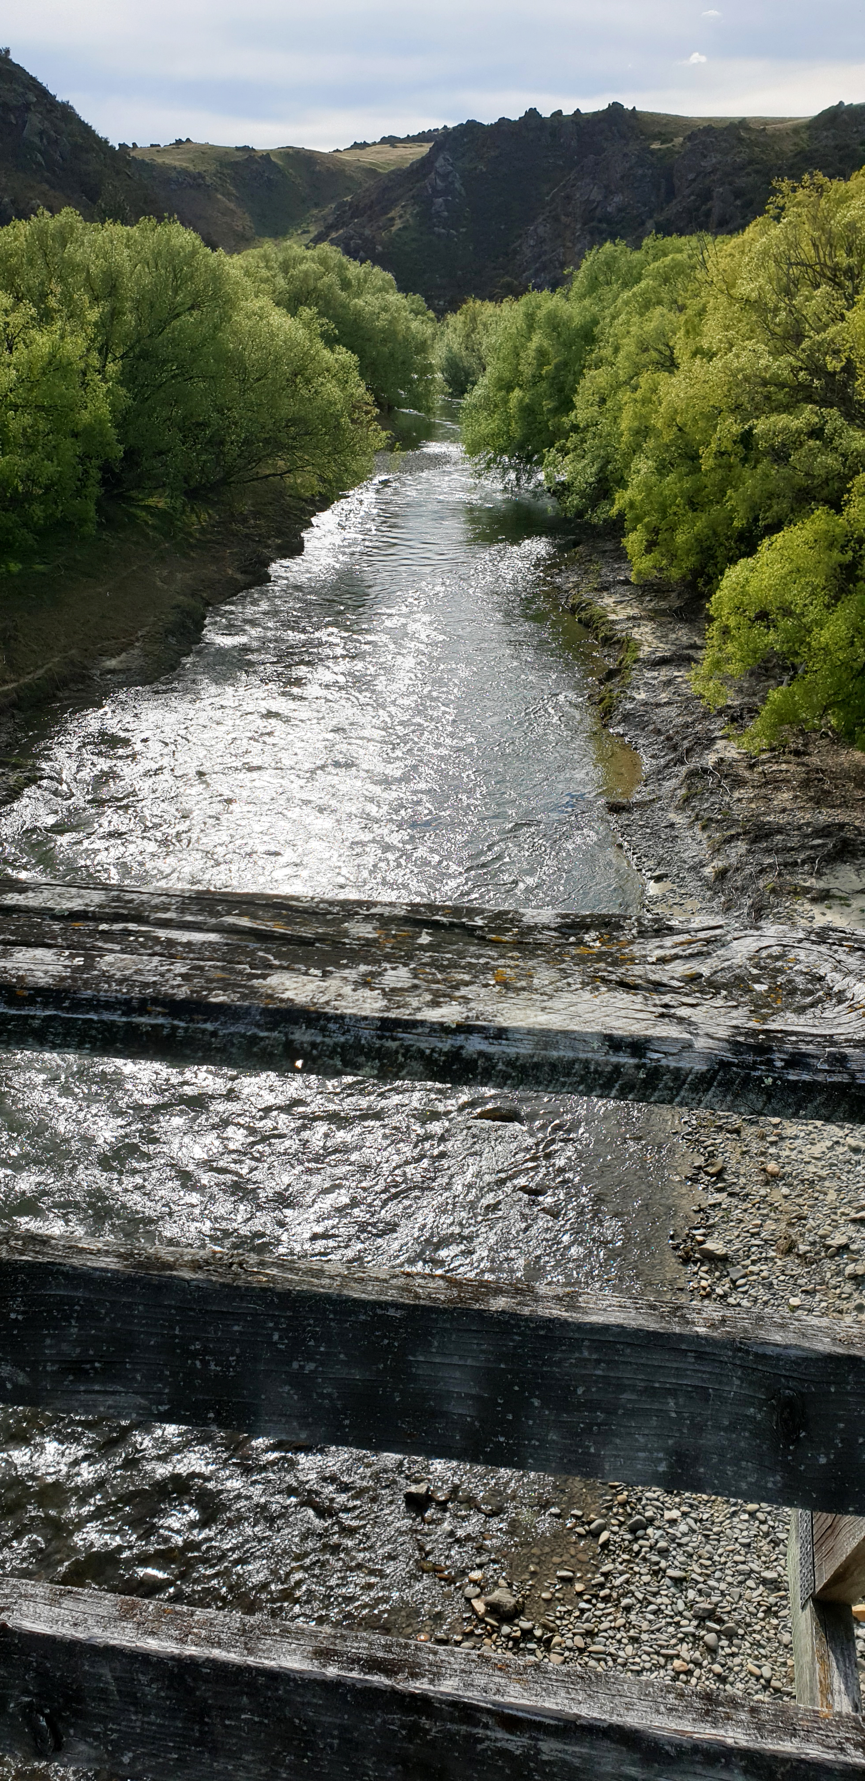
Areas of focus
Biodiversity
Wetland management
Water quality / rivercare
Recreation
Farming and Land Use
Community
Notes:
Six groups of activities, or areas of focus
As always, some groups engage people more than others

Slide 4
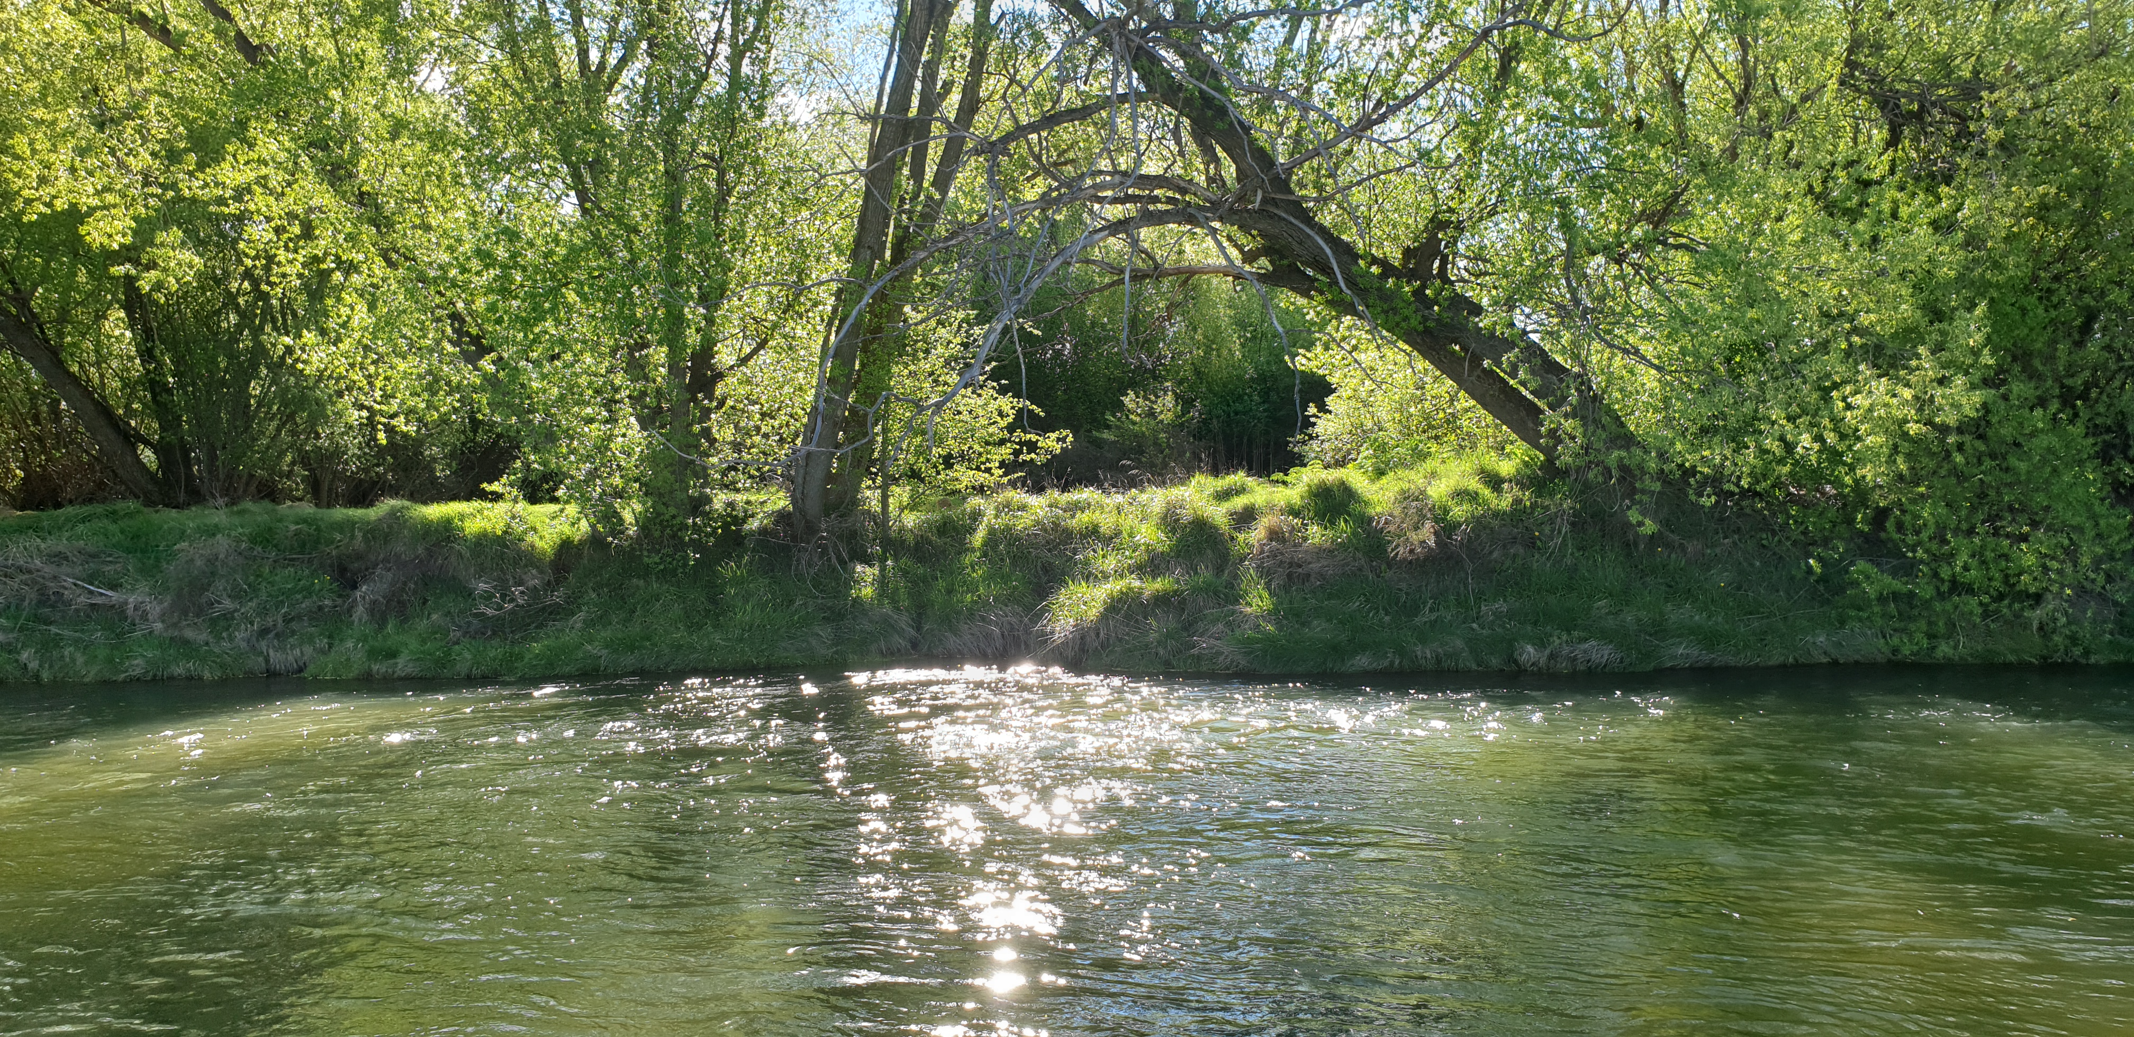
Resourcing for project
Clare Hadley – overall project management
Annie Wallace – focusing on biodiversity, wetlands and farming and land use
Craig Grant – focusing on community, water quality, recreation
Emily Hart – administrator
Lee Cowan – communications

Slide 5
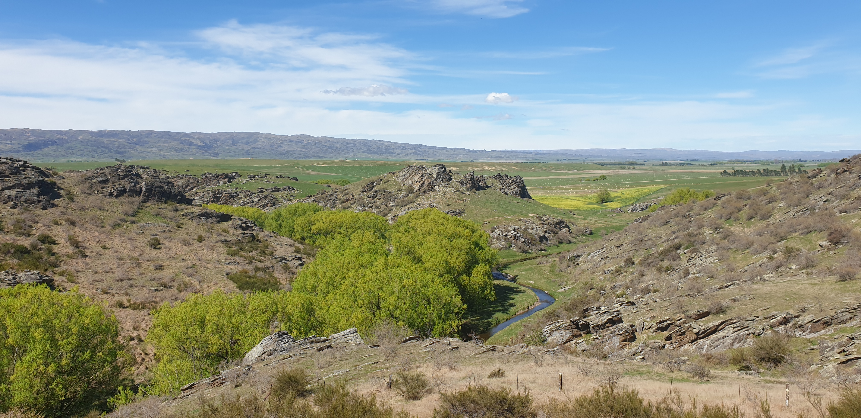
Project Groups
Project groups have been set up to support work
Representatives from ORC, CODC, DOC, MPI, NZ Landcare Trust, Aukaha, local farmers.
Notes:
Structure proposed of officials groups probably more for major urban centres
Project groups have worked really well for biodiversity and wetlands
For other activities, it’s been harder to get representation for the project groups
Fair amount of voluntary fatigue

Slide 6

The first six months of Waiora Manuherekia
Setting up the project structure, project groups, building relationships with the community, promoting the project to the community and building awareness.
Biodiversity: Willow removal
Community: Clean ups at favourite river spots
Water quality / river care: Engagement with local schools
Recreation: Mapping of access sites to the river and trails around the river
Farming and Land Use: Workshops and modelling of catchment
Wetland management: Mapping of catchment / restoration and protection
Notes:
Sites: Pool Burn Gorge, Hills Creek, Lauder Creek, Above Falls Dam, Below Falls Dam to SH85 at Blackstone Weir.
Funding available for restoration and protection / 15 Expressions of interest received / Recommendations to Governance Group later this week.
Had a very successful drone demonstration session last week

Slide 7
What’s working well
Partnership with Ngai Tahu, Riverside Trust and Councils through funding to Riverside Park project to remove willows from the banks of Manuherekia and construct a track from the bottom of Tarbert Street around to the Linger and Die Reserve
Willow removal
Collaboration on wetlands
‘River of dreams’ competition for schools in the catchment

Slide 8
Our challenges
Funding is for only for 12-month period
Suffered particularly unseasonal weather which has battered rural sector
Economic conditions
Regulatory discussions
The community is resilient but there is also an impact of these conditions on farmer willingness / capacity to engage
Notes:
This came after a 9 month hiatus between Living Manuherekia and confirmation of funding)

Slide 9

www.mcg.org.nz/waiora-manuherekia

