Slide 1
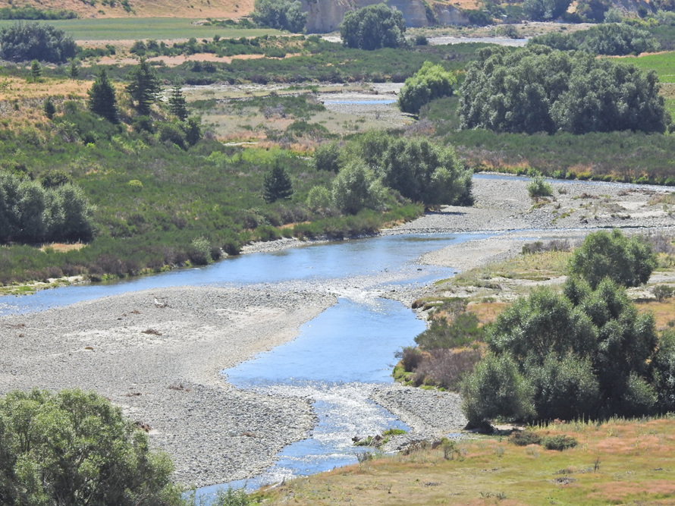
Manuherekia River Catchment
Ōtākou Marae
8th August 2019
Manuherekia Reference Group

Slide 2
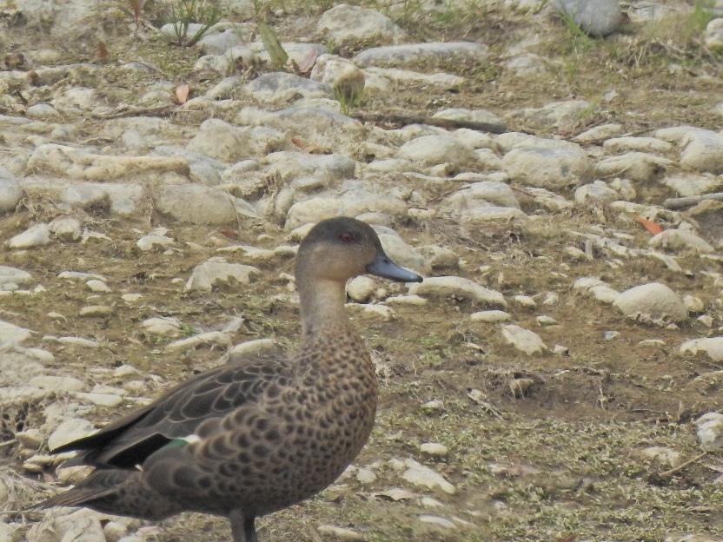
2. Mahika Kai
The name Manuherekia is descriptive (manu = bird, here = snare, kia = action)
Relates to the catching of waterfowl in the catchment
A locality noted for its mahika kai (places where food is produced or procured)
E.g. – a range of birds, eels, koura, raupō, fern root.

Slide 3
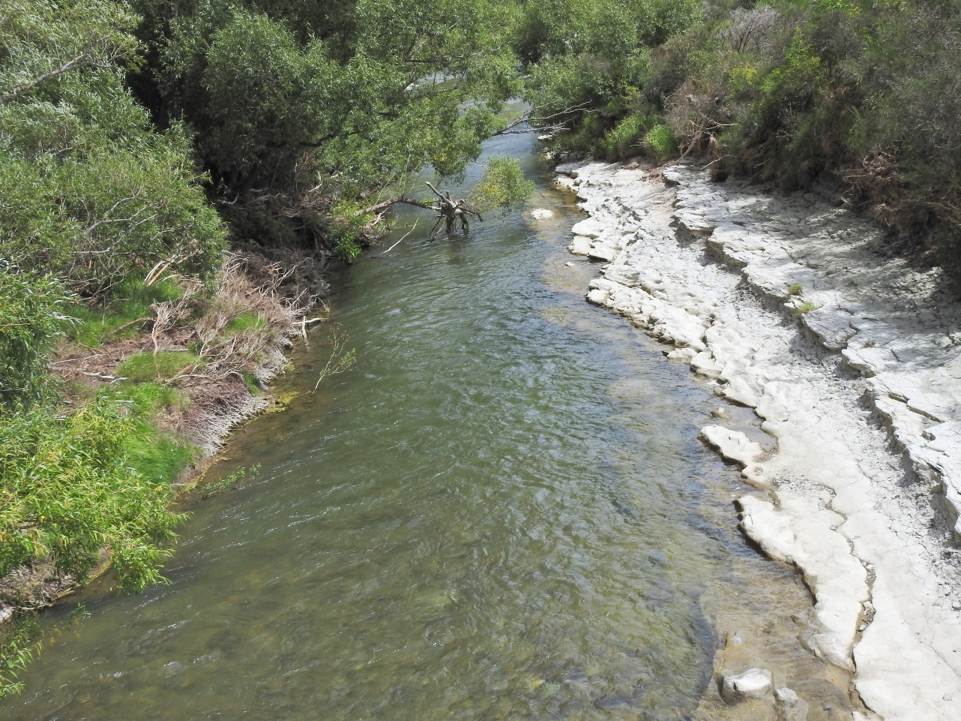
3. Mahika Kai
The mahika kai custom was established by the first people of the land, Waitaha
Subsequent arrivals followed the same pattern of resource use – i.e. the Kāti Māmoe, who in turn were followed by Kāi Tahu
The iwi merged over time, became known collectively as Kāi Tahu whānui
Mahika kai (mahinga kai) is central to Kāi Tahu
culture and identity
networks of trails and campsites linked hunter
gatherers to key resources
a seasonal activity for kin groups throughout
inland Otago region
access, campsites, hunting materials, catching,
sharing and preserving kai

Slide 4
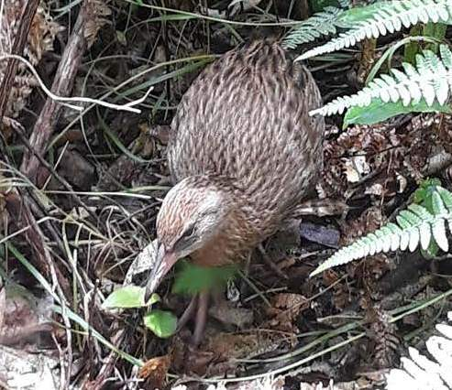
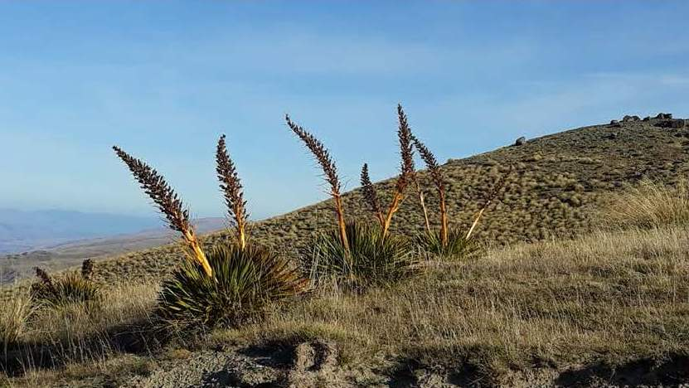

Slide 5
5. The Iwi and their World View
The iwi (Waitaha, Kāti Māmoe and Kāi Tahu) share a world view
Which extends back to the beginnings of time
Stages from the emergence of light followed by water, land, eventually life forms including people
Overseen by demigods such as Tāne, Takaroa, Tāwhirimātea, Tūmataueka to name but a few

Slide 6
6. Connectivity, past, present and Future
For Kāi Tahu the mountains, waters, lands possess mana
A whakapapa that interconnects, linking mana whenua to land and resource
A connection that elevates the relationship
A kinship based on reciprocity, spanning the past, present and future

Slide 7
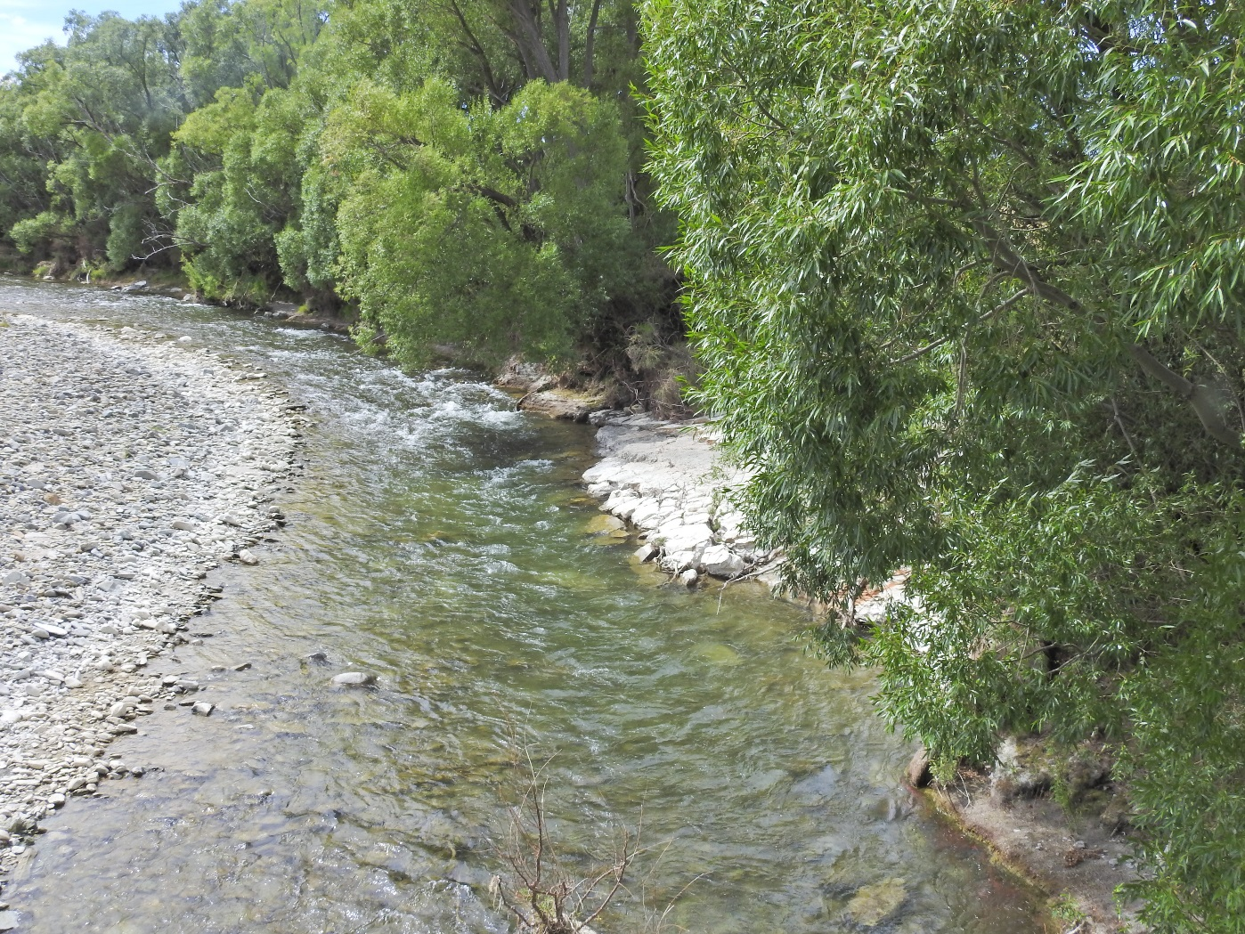
7. Naturalised State
For mana whenua understanding the wellbeing of the environment looks at the naturalised state
What would the state of abundance or life supporting capacity look like?
Does the current state equate with traditional accounts in pepeha (saying), waiata, proverb, kōrero?
Confirm connection, access, ability to gather kai, and learn customary knowledge?

Slide 8
8. Human Impact
The arrival of the first ancestors disrupted the natural balance
The ancestors evolved an ethos of spiritual connection to the natural world
Underpinned by notions of kinship, reciprocity and interconnectedness
Understanding the seasons, breeding habits, and sustainable take

Slide 9
9. Kaitiakitanga / Guardianship
Notions of tapu (prohibited) and noa (common or permitted) ordered behaviours
A time to take and a time not to take from the environment
The concept of kaitiaki or guardianship evolved
With rights came responsibility to future generations

Slide 10
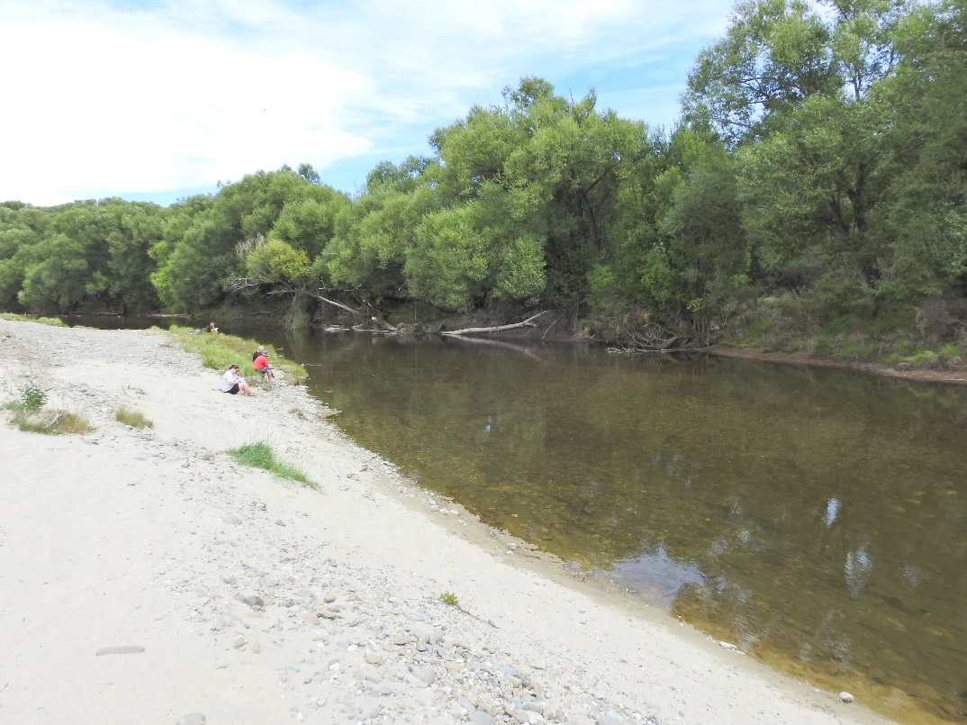
10. Human Impact
Mātauraka (mātauranga) or wisdom gained through experience, observation, and practice
Informs the custom of use and protection of resources
Remembered in place names, legend, stories, waiata and the practice of customary use
Reinforces the ethic of take enough for a feed, leave some for tomorrow

Slide 11
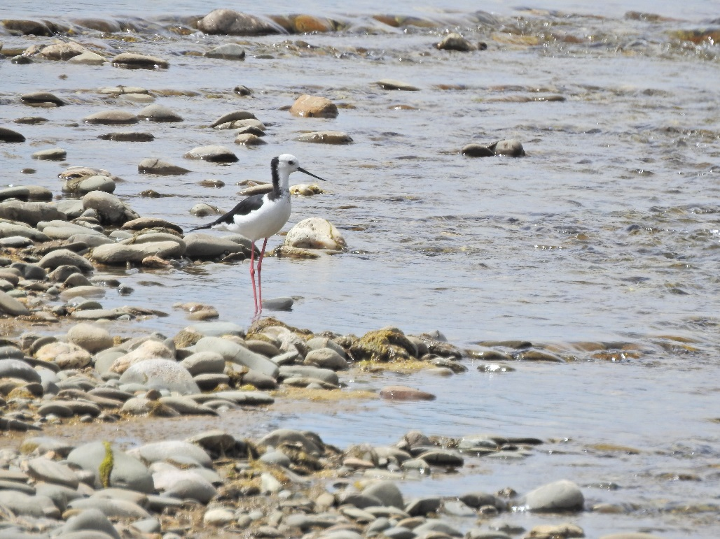
11. Traditional attributes of the
Manuherekia River Catchment
Awa (rivers and streams);
Ara tawhito (ancient trails);
Taoka species (mainly birds and fish);
Mahika Kai (places where resources including food were/are procured);
Mauka (important Mountains);
Kāinga Nohoanga (occupation, settlement sites);
Ingoa Tawhito (place names);
Tauranga waka (landing sites);
Landcover;
Puna (springs);
Repo raupō (wetlands and swamps).

Slide 12
Traditional Placenames for Manuherekia catchment

Slide 13
13. Right to speak on Customary Interests
Ko wai nō hea? – who am I and what right do I have to kōrero on the subject?
I am of the Ōtākou hapū Kāi Te Pahi, who are among the hapū (from Moeraki, Puketeraki, Ōtākou & Hokonui) who hold customary rights in the interior of Otago
Rights exercised by the forbears over the centuries
Rights originally defined through either discovery or naming the land or conquest or marriage or gifting, rights not ceded to date

Slide 14
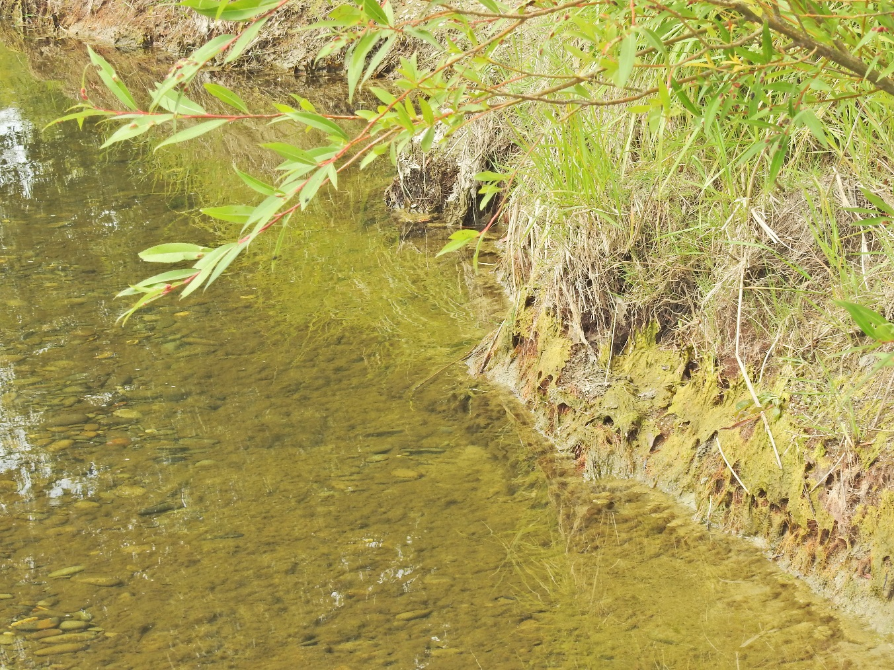
14. Te Mana o Te Wai (NPSFM 2017)
The concept “Te Mana o Te Wai” sits comfortably into the cultural world view
The NPSFM require consideration and recognition of the interconnections between water and the broader environment:
To the health of the environment, waterbody and people
To set values through broad community discussion including with tāngata whenua
To inform setting freshwater objectives and limits

Slide 15
15. Te Mana o Te Wai (NPSFM) continued;
Te Mana o Te Wai can include for example:
The holistic health and wellbeing of water bodies in all its forms, incorporating;
the connections between surface and ground water, flowing or ephemeral;
water quantity and quality;
presence, quality and abundance of traditional species;
quality of bed and riparian margins;
connection of mana whenua to the waterbodies;
the ability of the waterways to sustain mana whenua practices associated with the waterways including, environmental, social, cultural and economic

Slide 16
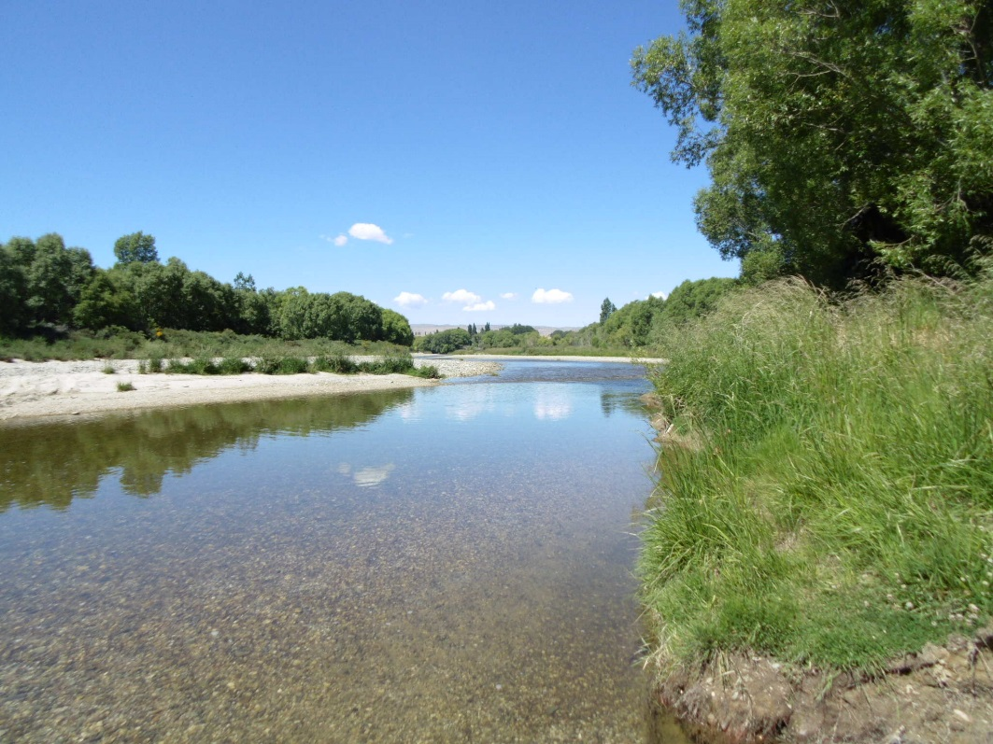
16. Part D of the NPSFM
Objective D1 states;
“To provide for the involvement of iwi and hapū, and to ensure that tāngata whenua values and interests are identified and reflected in the management of fresh water and associated ecosystems, and decision-making regarding freshwater planning…”

Slide 17
17. The RMA
Section 5 contemplates environmental preservation and protection as an element of sustainable management of natural and physical resources; and protecting the environment from adverse effects of use and development.
Section 6 identifies matters of national importance, and directs us to recognise and provide for them, I draw your attention to S6(e) “The relationship of Maori and their culture and traditions with ancestral lands, water, sites, waahi tapu, and other taonga”.
Section 7 requires particular regard be given to eleven matters, including “kaitiakitanga”.
Section 8, directs taking into account the principles of the Treaty of Waitangi (Te Tiriti o Waitangi).
Important as Part 2 is, where specific, unqualified provisions in a superior instrument¹ by which Part 2 is given effect (the lawfulness and the meaning of which are not in dispute, and which “cover the field”), we are not free to “refer back” to Part 2 to diminish the effect of the superior instrument².
¹Such as a national policy statement or a regional policy statement.
²Environmental Defence Society v NZ King Salmon, cited above, [80], [88].

Slide 18
18. Te Rūnanga o Ngāi Tahu Act (1996)
This Act recognises Ngāi Tahu Whānui as tāngata whenua for the larger part of the South Island and the entire Otago region. The iwi authority, Te Rūnanga o Ngāi Tahu, exercises the statutory powers invested in it to act in the interests of Ngāi Tahu Whānui on matters of natural resource management across the tribal territory, including Otago.
The interests of tāngata whenua are represented by more than one Papatipu Rūnanga located in the Otago region.

Slide 19
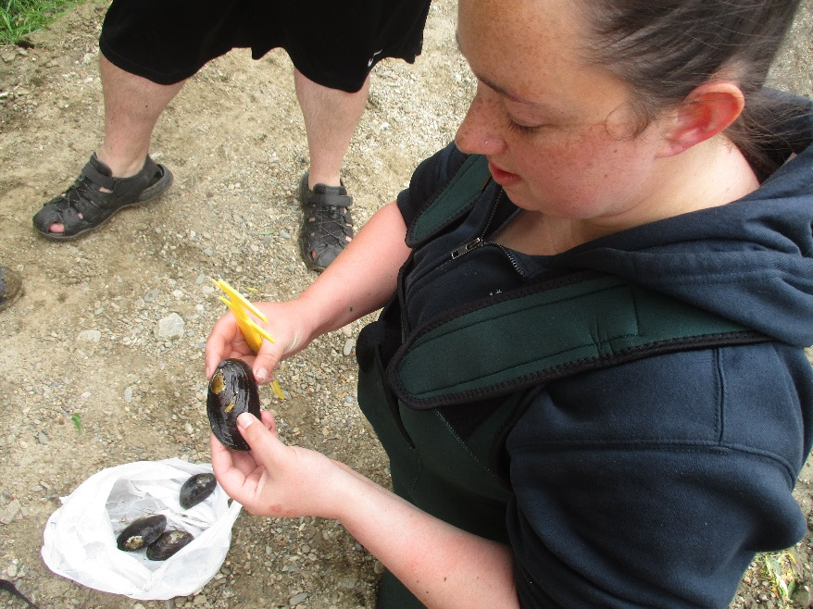
19. The Ngāi Tahu Claims Settlement Act (1998)
This Act provides for the following in the Otago region:
Statutory Acknowledgements over a number of lakes, rivers and wetlands each of which includes a statement describing the Ngāi Tahu relationship and association with each waterbody and catchment; and
Nohoanga (camp sites) in the Otago region, located adjacent to waterbodies and chosen for their proximity to traditional mahinga kai places and resources; and
Taonga species schedule of bird, plant, fish and marine mammal.

Slide 20
20. Kāi Tahu ki Otago Iwi Resource Management Plan (2005)
This iwi resource management plan identifies values, issues, objectives and policies on resource management / natural environment matters in the Otago region, including the Clutha / Mata-Au catchment.
Please note: The foregoing speaks of and respects the continuum between past, present and acknowledges the future, i.e.; Kāi Tahu are not consigned to fossils and past memories, but are valid participants in the future planning and management of the Manuherekia River catchment with legitimate expectations.

Slide 21
21. Recent Whānau Observations
More recent than 2005, whānau have observed the following issues in the Manuherekia River Catchment;
Over allocation of water
Sedimentation
Reduction in habitat
River modification
Water deterioration and eutrophication
Harvest and removal of vegetation and shelter
Barriers for fish passage
To this list can be added issues of flow, surface and ground water interaction, remnant wetlands, loss of braids, habitat (availability, diversity, quality), temperature, oxygen levels, success of feeding for indigenous species, population structures of taoka species, growth rates, reproduction and behaviour of species.
All of which have impacts that include alienation, loss of relationships, inability to manaaki and loss of access and mātauraka. Above the importance of assessing effects in a cumulative manner.

Slide 22
22. Whānau reminisces
Whānau with long term association with the Manuherekia River observed the following memories they had of the rivers former characteristics;
A variety of diverse features found at different places in the catchment, each supporting a different type of use.
Different locations being used as swimming holes by different age groups.
The river having sufficient depth to be traversed by kayak or tyre tubes.
No algae present at swimming holes.
The waterway sustained fish including large eels.
Sites were accessible for swimmers.
There was a strong current, but there were also safer calmer places where people could go.
There was a greater flow in the past.
There were sites where a person could retreat and refresh.
A range of species were present: eels, koura, fish, insects, watercress.
Activities on the Manuherekia are being substituted by use of the Clutha River, which is not a safe alternative.

Slide 23
23. Miners Anxiety recorded from 1873
“Some anxiety in this regard can be seen in the miners’ petition from 1873 complaining that mining opportunities might be lost if they had to abide by the provision in the Gold Fields Act requiring two heads of flow to be retained in the natural watercourse for public use.”
Mount Ida Chronical, 25 July 1873, pp 3-4
It is very apparent from the official and public record that many Otago water rights were acquired knowingly with low reliability
Instances where priority rights trump permits for agricultural rights

Slide 24
References
References include:
Taiaroa Papers 1880
“Ka Huru Manu”, Ngai Tahu placenames project
Manuherekia Final Values Report, 2018
Kai Tahu Ki Otago Iwi Resource Management Plan
NPSFM (2017) and RMAct 1991
Mount Ida Chronical
Draft Manuherekia Report, August 2019 (Tipa Associates)
Photo references:
Slide 1 – Braided section near Blackstone
Slide 2 – Grey teal (taonga species) at Campground
Slide 3 – Manuherekia at Blackstone
Slide 4 – Weka at Abel Tasman National Park
Slide 4 – Taramea, Old Man Range (near Kopuwai)
Slide 7 – Manuherekia at Blackstone
Slide 10 – Whānau assessing river health at Omakau
Slide 11 – Pied stilt (taonga species) at Fisher Lane
Slide 14 – Riparian margin at Fisher Lane
Slide 16 – Manuherekia at Fisher Lane
Slide 19 – Measuring kākahi at Outram Glen

