Slide 1
Enviroschools
Leisa de Klerk
Regional Coordinator Lead
Creating a healthy, peaceful, sustainable world through learning and taking action together.
Notes:
Ka mihi ki a Ranginui, ki a Papatūānuku, Ka mihi ki te ngao o te wheiao! Toitū te whenua, toitū te tangata ki te wheiao ki te ao mārama.
Session outline: Introduce our kaupapa, look at the structure and funding of the organisation and where ORC fits into this.
Talk about how we work with schools and the community
Talk about two larger projects we are involved in

Slide 2
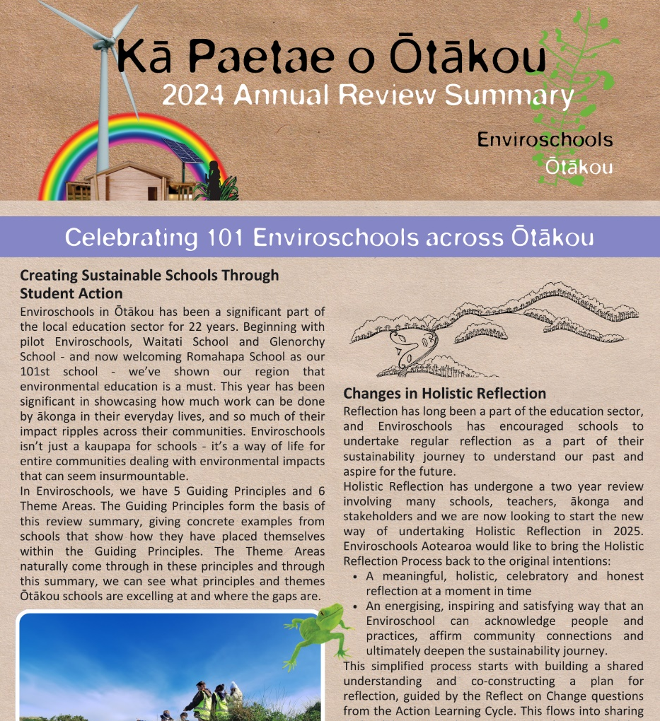
Our 2024 Annual Review Summary
Showcases the actual mahi students are doing in their schools in line with the Guiding Principles:
Empowered Learners
Learning for Sustainability
Te Ao Māori
Respect for Diversity
Sustainable Communities

Slide 3
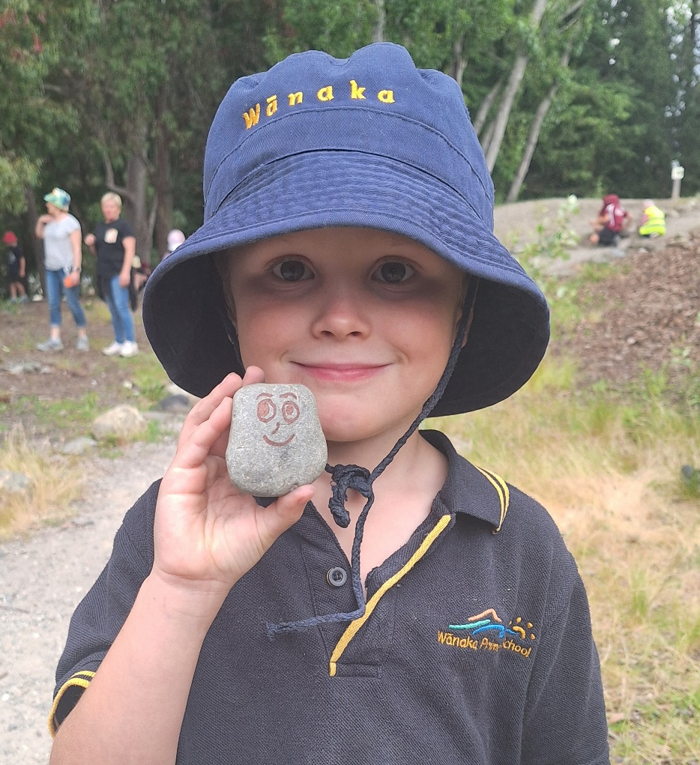
A Successful Year for Enviroschools
2024 saw the induction of our 101st Enviroschool, reaching over 28,000 students across Otago.
90% of schools are primary or secondary.
Our team consisted of 2 Regional Coordinators and 9 Facilitators across the region.

Slide 4
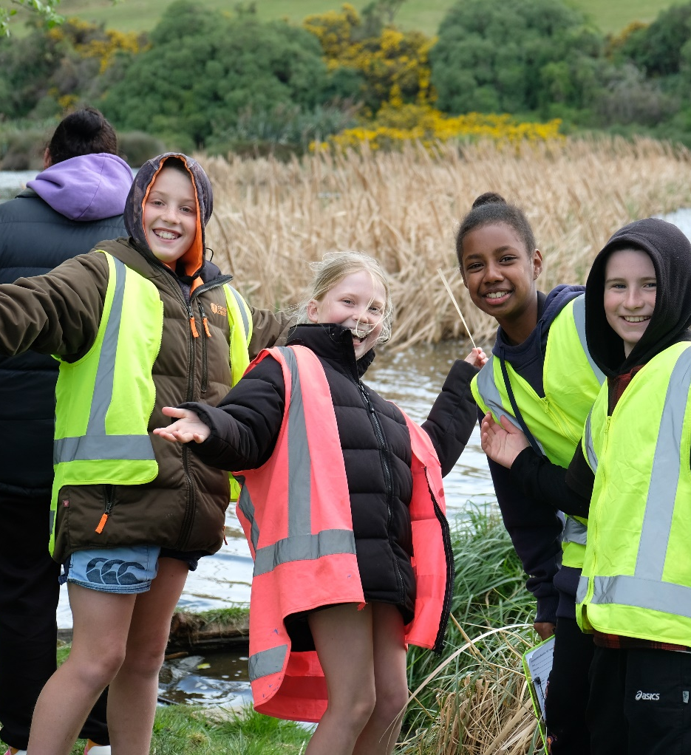
Successful Holistic Hui
Across Ōtākou, 16 hui were held, reaching over 50 schools and engaging over 500 students and key teachers.
Each area/district aims to have at least 3 hui a year for both teachers and students.

Slide 5
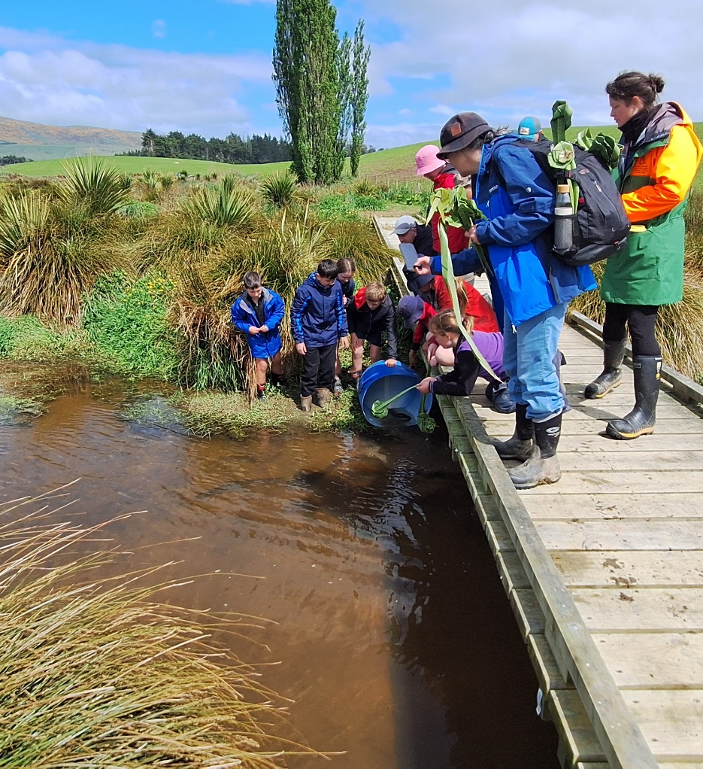
Strong Collaboration
We worked with 9 regional partners and 18 collaborators.
These partners and collaborators supported all 16 of our hui in 2024, usually with funding and/or presenters.

Slide 6
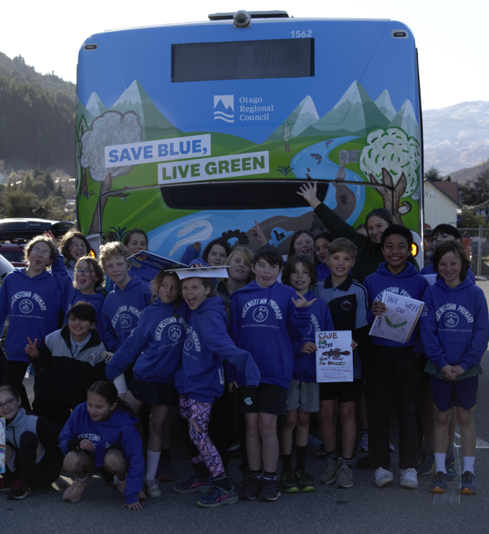
Queenstown Primary School
Last year, Queenstown Primary School and Otago Regional Council collaborated to create this bus back encouraging the community to report pollution.

Slide 7
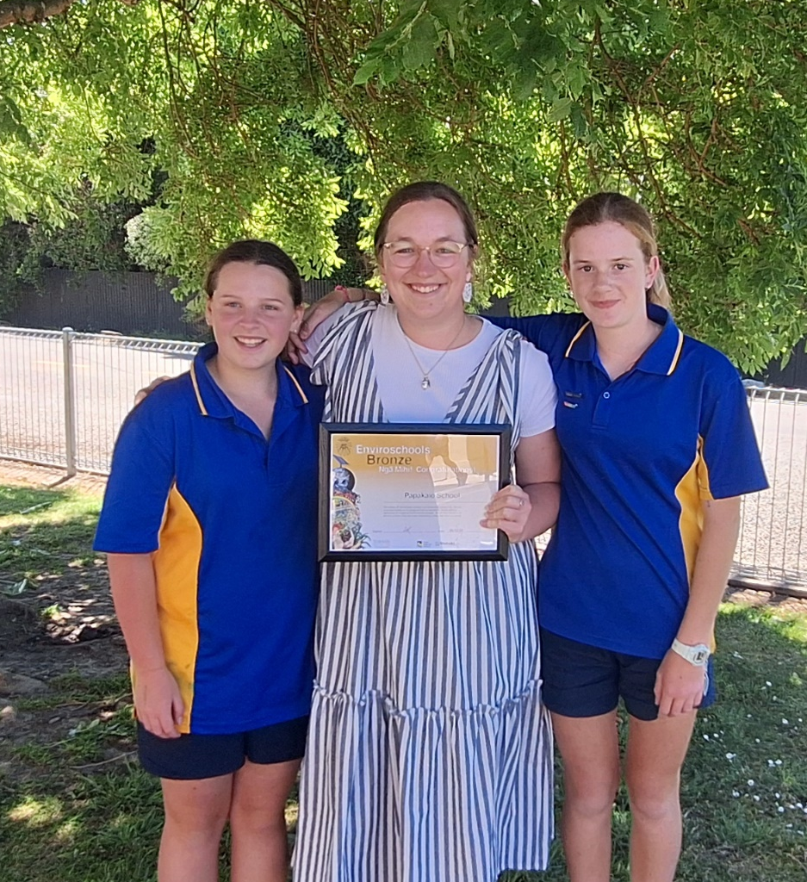
What’s Next for 2025
New RC and Dunedin Facilitator starts in April.
19 student and teacher hui are planned across Otago for the year.
South Island Facilitators hui hosted by Dunedin.
New holistic reflection process starts, moving away from the bronze, silver and green-gold.

Slide 8
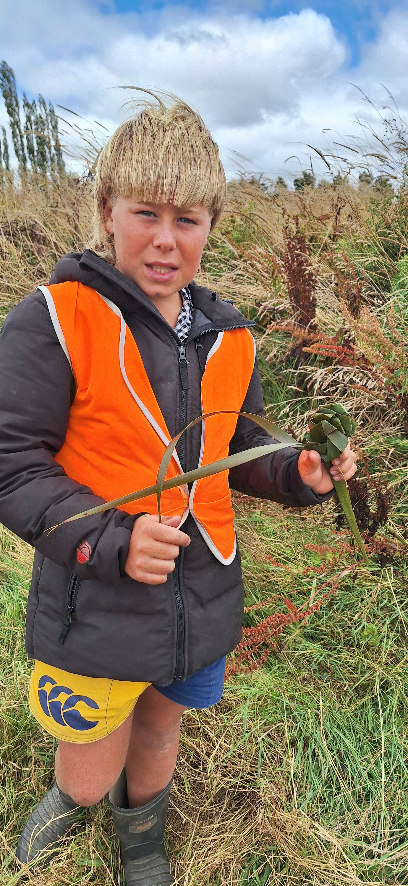
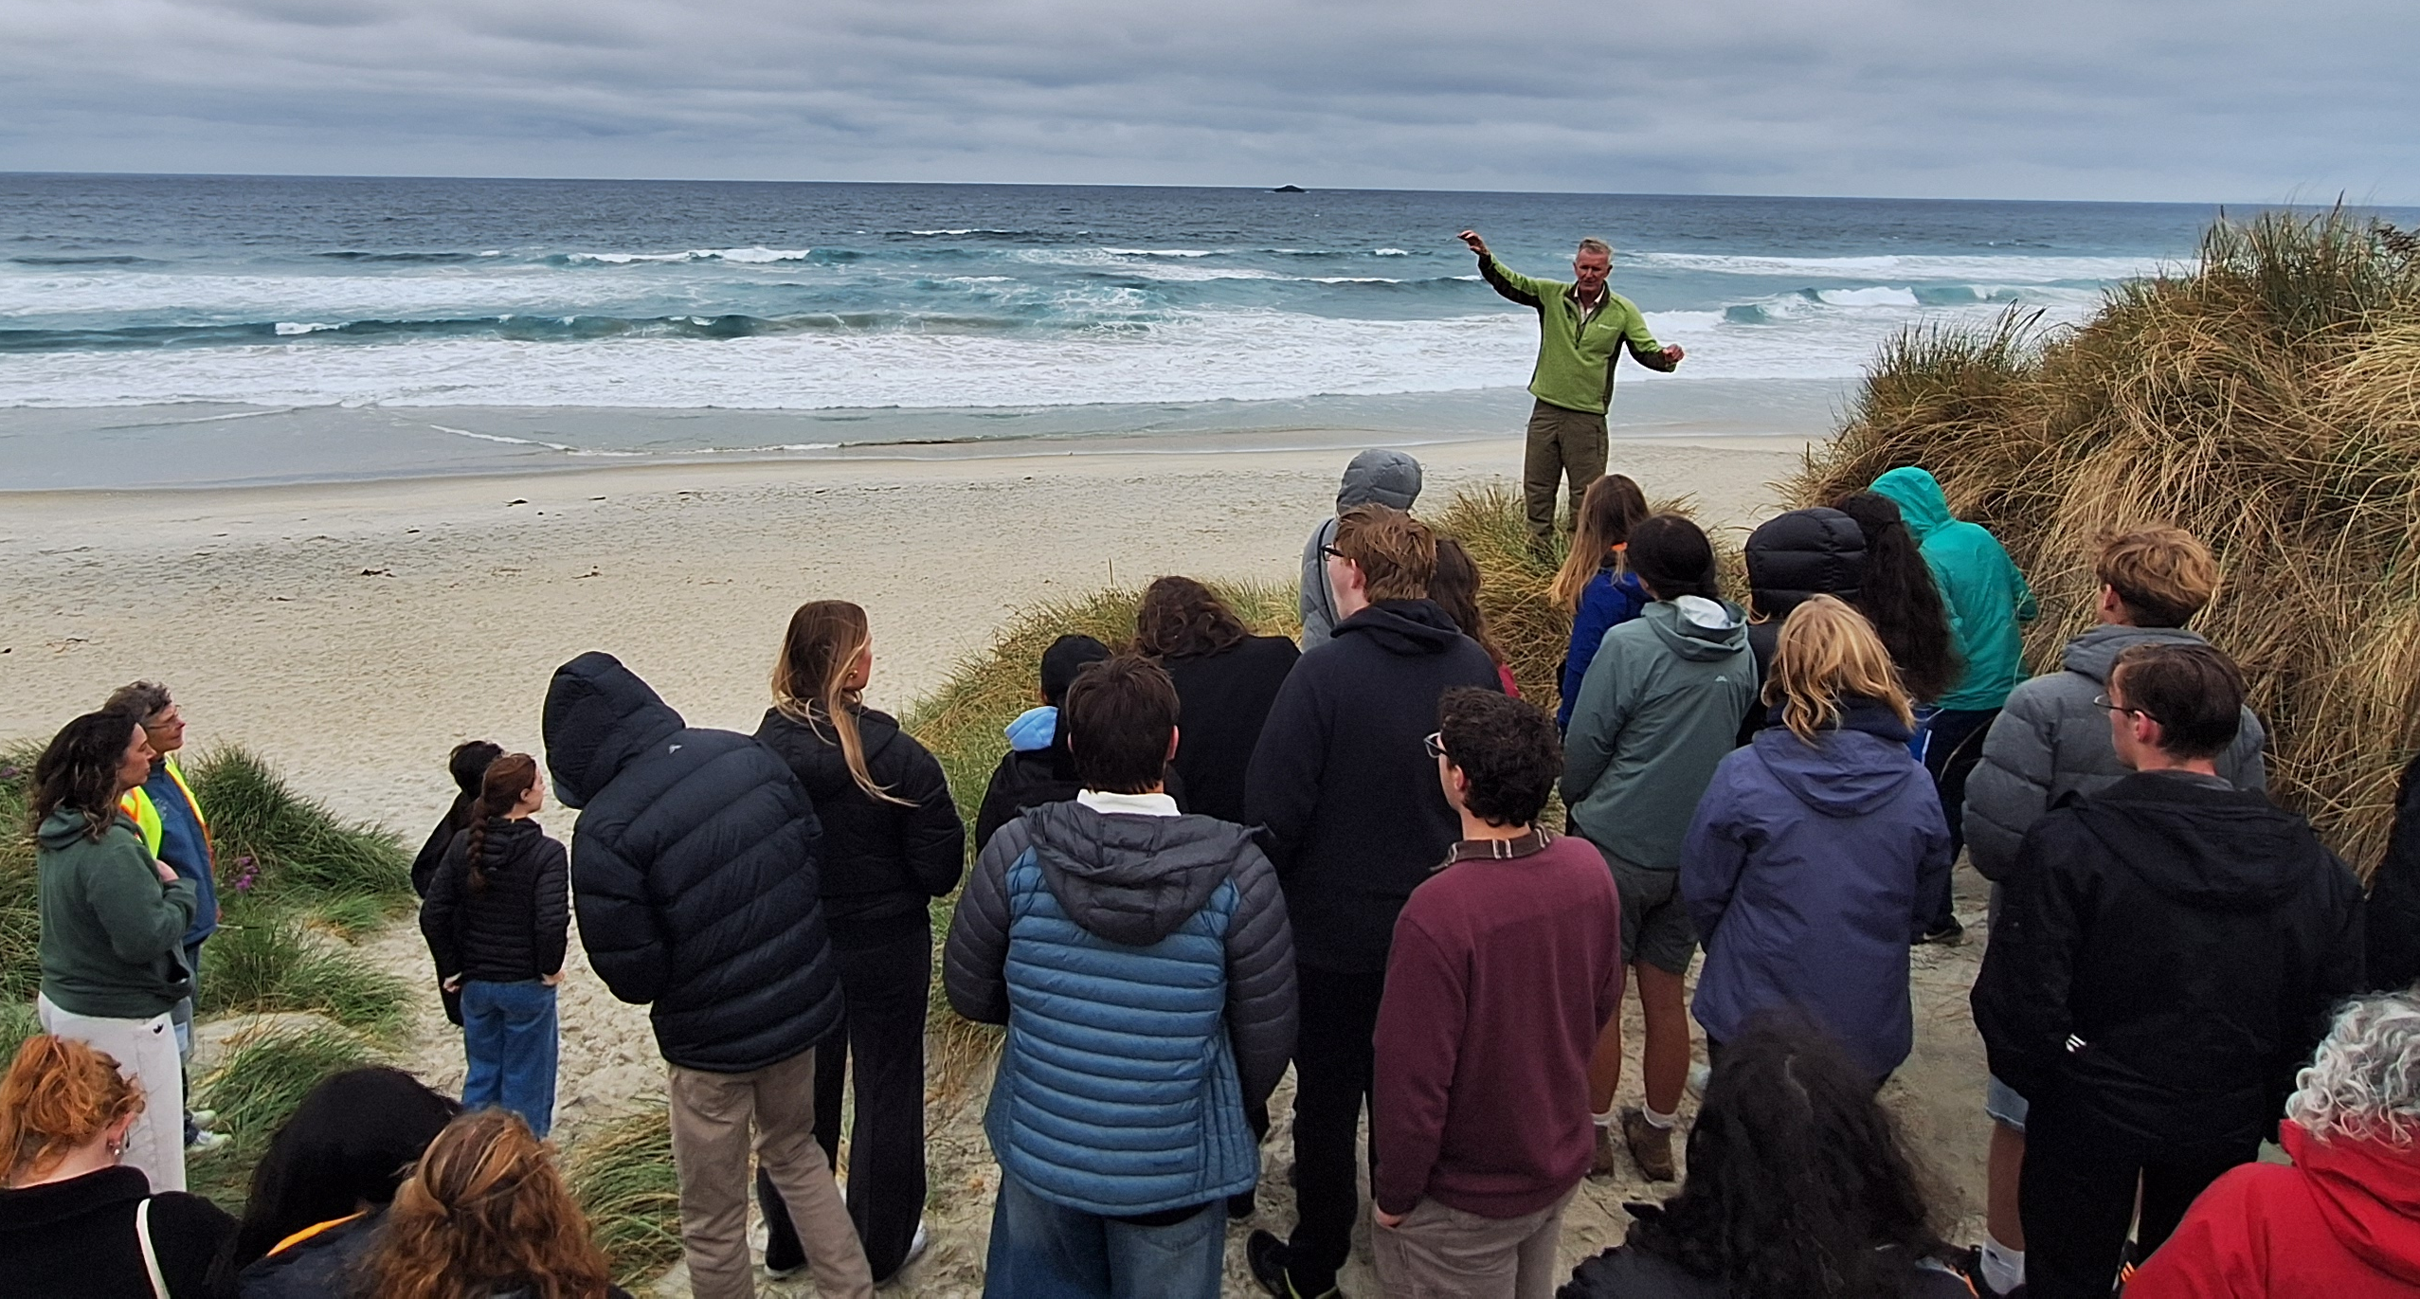
Future Aspirations
Youth Jam for South Island Secondary School Enviro Leaders in 2026.
Increase in number of Enviroschools Early Childhood Centres.

Slide 9
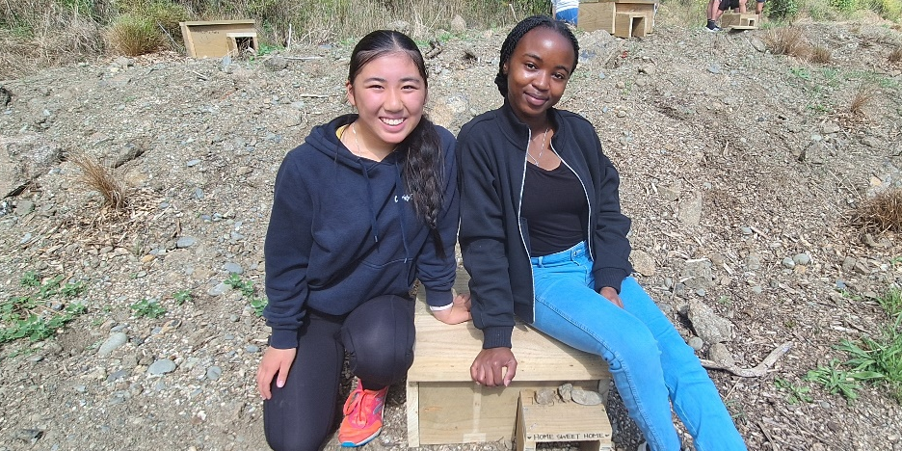

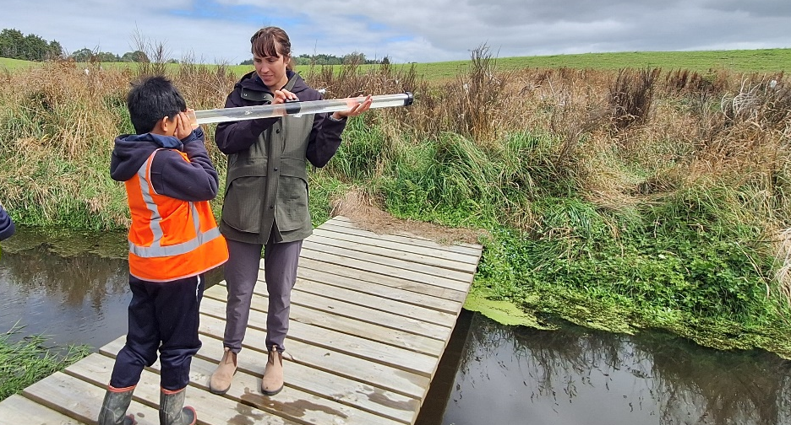
Guiding Principles in Action

Slide 10
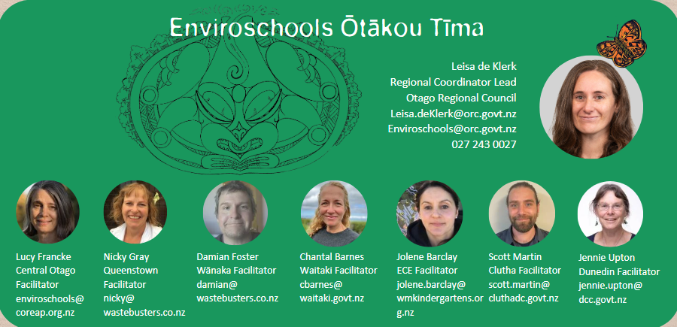
Our Team

Slide 11


Add your logo to the white panel and contact info below
enviroschools.org.nz/
facebook.com/EnviroschoolsOtago
instagram.com/enviroschools_otago/
Phone: +64 27 243 0027
Email: Enviroschools@orc.govt.nz
Notes:
This was a brief over-view of Enviroschools, our kaupapa and structure and where ORC fits in this picture, how we contribute to ORC’s priorities.
There are lots of exciting things happening in schools and communities and many schools are deepening their sustainability practices.
One of my roles is to see what the other regions are doing. A great initiative that some councils in other regions are doing is providing a transport fund to cover the cost of buses to get students to environmenmental education opportunities- transport is often the stumbling block that stops students being able to go off-site. This is something I would like to consider for Otago if the councillors were open to that as part of the LTP discussions – this could be one way for ORC to support all Otago schools, not just Enviroschools.
Find out more at the Enviroschools Website and on our facebook page.
Thankyou very much for your time this morning. Are there any questions.

