Slide 1
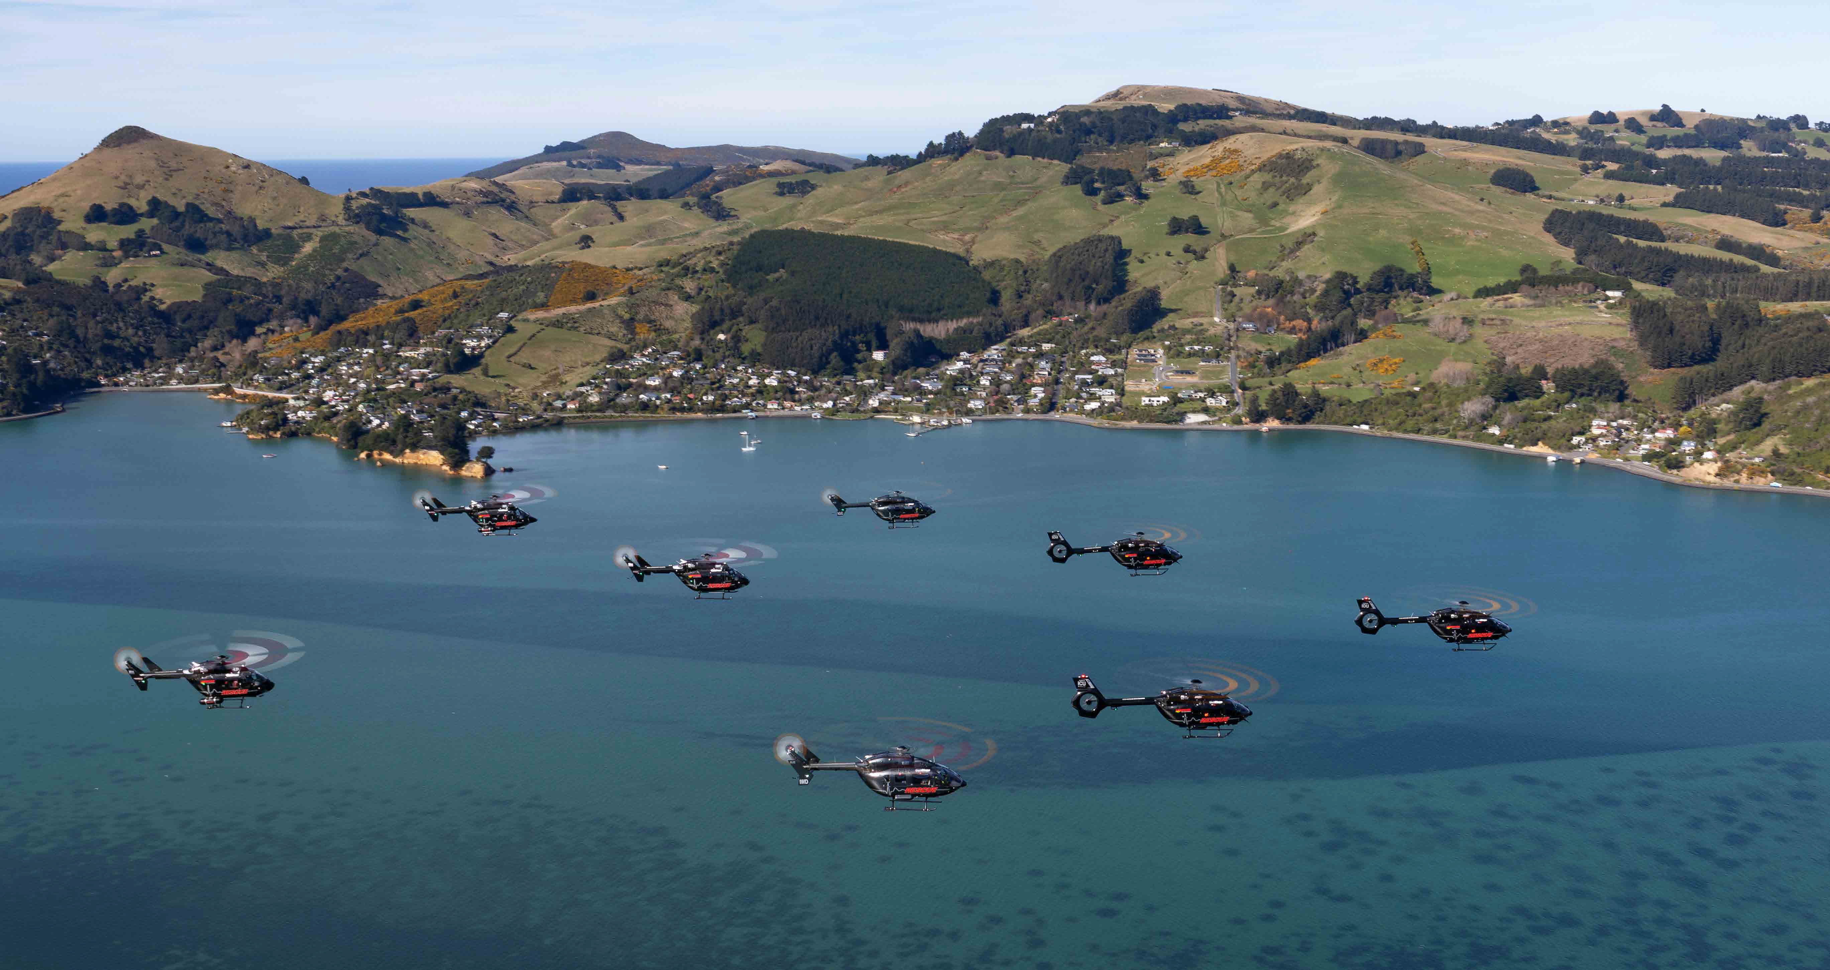

OTAGO SOUTHLAND RESCUE HELICOPTER TRUST 2025 PRESENTATION TO OTAGO REGIONAL COUNCIL for the year ended 30 June 2025

Slide 2
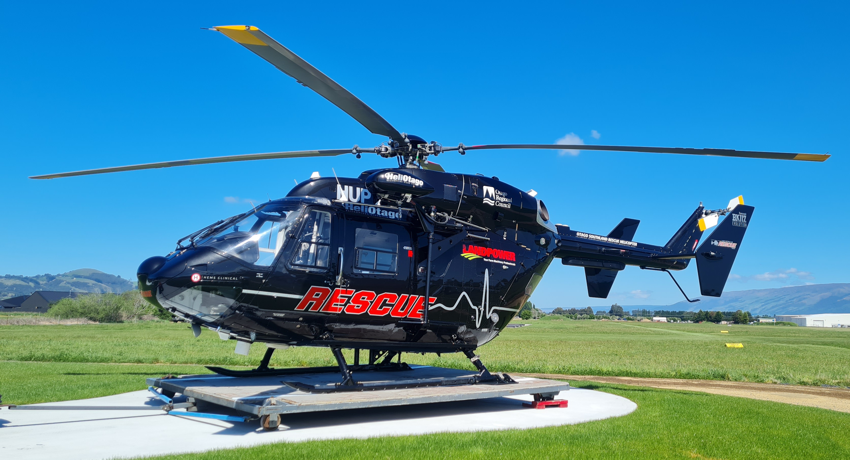
OTAGO SOUTHLAND RESCUE HELICOPTER TRUST 2025 PRESENTATION TO OTAGO REGIONAL COUNCIL for the year ended 30 June 2025
Key Statistics:
Missions flown:
2024 2025 change
Accident 553 621 +12.3%
Medical Emergency 457 490 +7.2%
Hospital Transfer 941 946 +0.5%
Search & Rescue 106 108 +1.9%
_____ _____
Total Missions 2,057 2,165 +5.3%
Patients Carried 1,883 1,998 +6.1%
*includes across lower South Island

Slide 3
OTAGO SOUTHLAND RESCUE HELICOPTER TRUST 2025 PRESENTATION TO OTAGO REGIONAL COUNCIL for the year ended 30 June 2025
Key Financials:
2024 2025
$000 $000
Total Revenue 1,762 1,766
Total Expenses 1,168 1,158
Surplus before bequests 594 608
Total Comprehensive
revenue and expenses 776 944

Slide 4
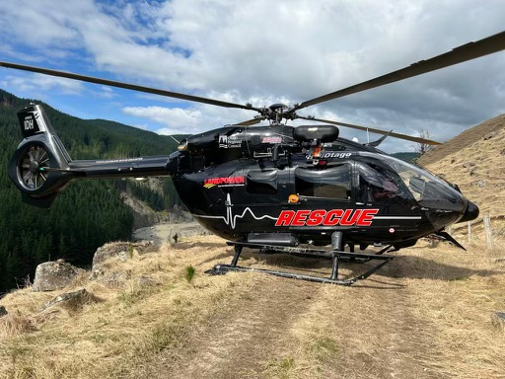
OTAGO SOUTHLAND RESCUE HELICOPTER TRUST 2025 PRESENTATION TO OTAGO REGIONAL COUNCIL for the year ended 30 June 2025
Significant Donors:
Otago Regional Council
ILT Foundation
Community Groups and Individuals
Bequests

Slide 5

OTAGO SOUTHLAND RESCUE HELICOPTER TRUST 2025 PRESENTATION TO OTAGO REGIONAL COUNCIL for the year ended 30 June 2025
Family of Sponsors
Platinum Sponsor –
Landpower Group Ltd
CLAAS Harvest Centre Network
Silver Sponsor - Network Waitaki (renewed)
Bronze Sponsor – Ravensdown Ltd (renewed)

Slide 6
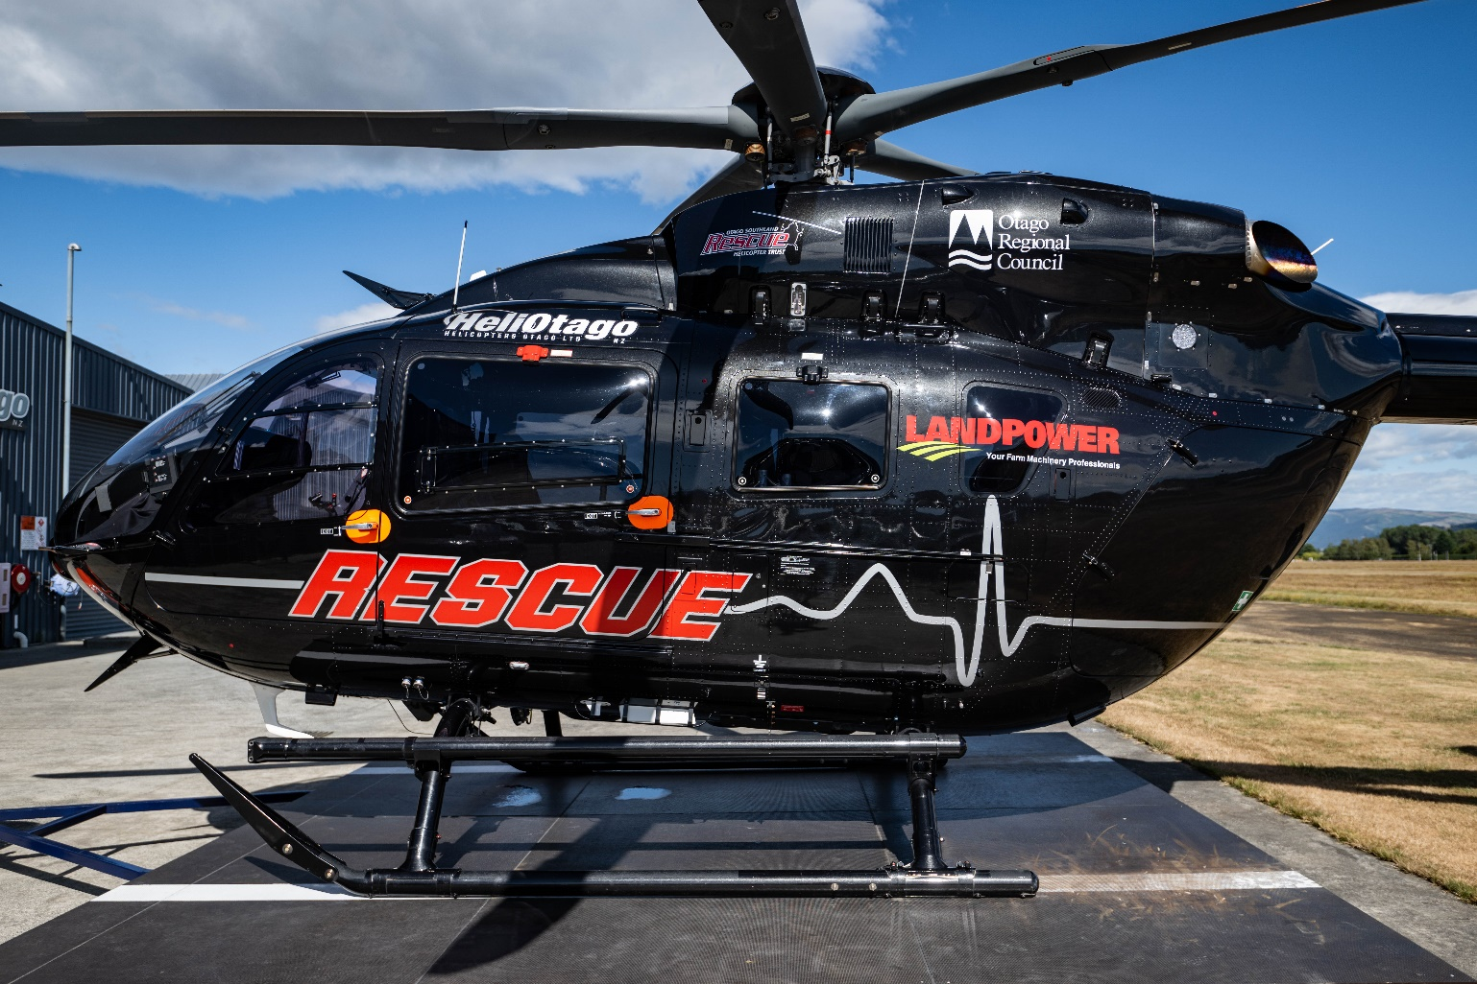
OTAGO SOUTHLAND RESCUE HELICOPTER TRUST 2025 PRESENTATION TO OTAGO REGIONAL COUNCIL for the year ended 30 June 2025
Contract with Health NZ Te Whatu Ora/ ACC
Renewed from 1 November 2022 for a four-year
term with ROR at purchasers’ discretion
Discussions commencing for 2026
Trust, as co-funders with the Crown, provide
annual funding ($800k pa + LDART $400k pa)
as well as requests for additional items “outside”
of the contract with the Crown
– such as IFR routes and additional equipment

Slide 7
OTAGO SOUTHLAND RESCUE HELICOPTER TRUST 2025 PRESENTATION TO OTAGO REGIONAL COUNCIL for the year ended 30 June 2025
IFR Routes and Helipads:
IFR routes – infrastructure essentially
completed after work over past decade.
Helipads – further community funded
helipads established and more in development

Slide 8
OTAGO SOUTHLAND RESCUE HELICOPTER TRUST 2025 PRESENTATION TO OTAGO REGIONAL COUNCIL for the year ended 30 June 2025
World Class Service – Supported by our Community
Held a community engagement event in Oamaru with excellent response
Excellent engagement on social media – now 10k followers on Facebook.

Slide 9
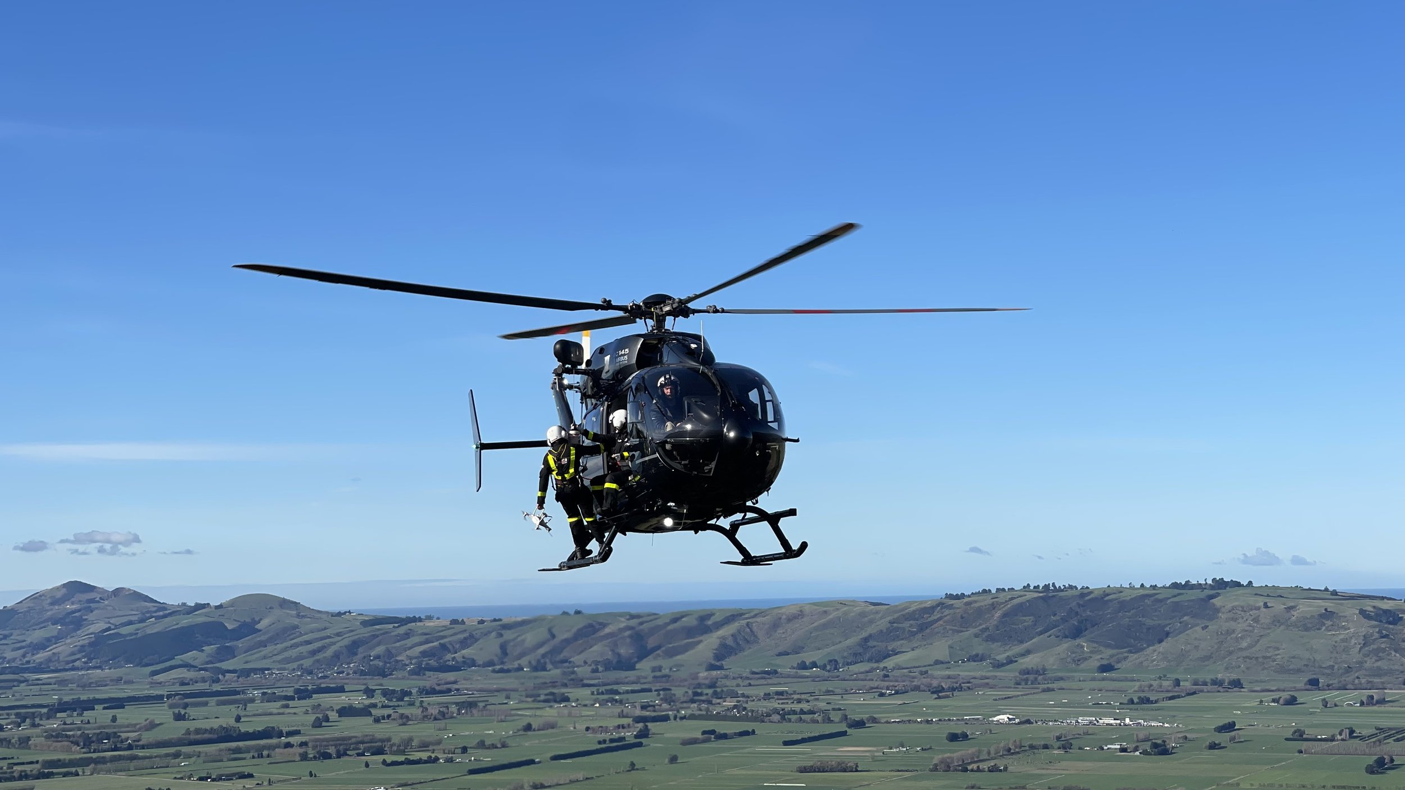

OTAGO SOUTHLAND RESCUE HELICOPTER TRUST 2025 PRESENTATION TO OTAGO REGIONAL COUNCIL for the year ended 30 June 2025
Thank you to:

