Slide 1
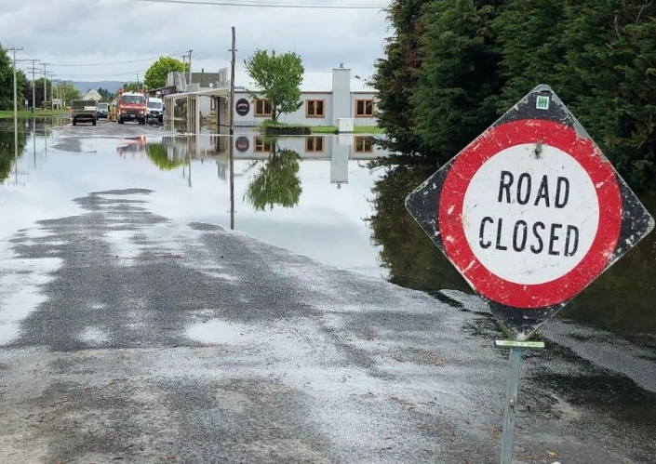
Middlemarch Flood Investigation

Slide 2
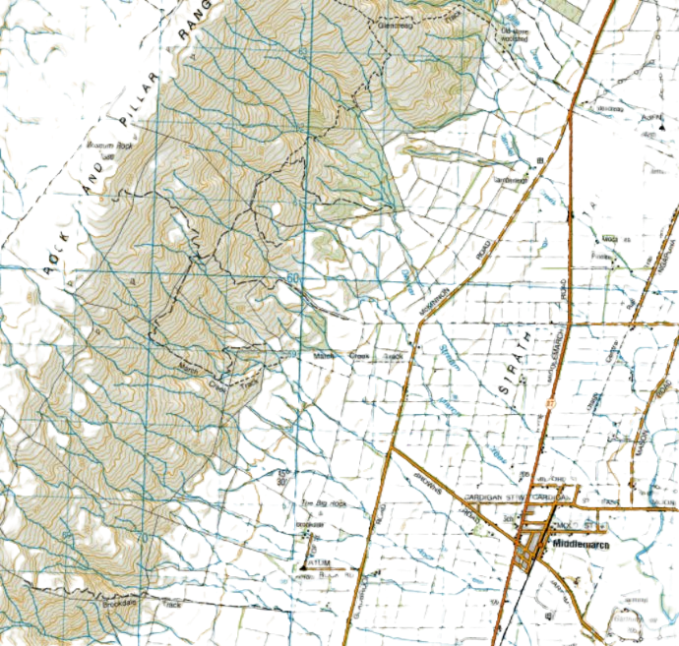
Overview
DEWAR STREAM
MARCH CREEK
ROCK CREEK
TAIERI RIVER
UNNAMED
CREEK

Slide 3
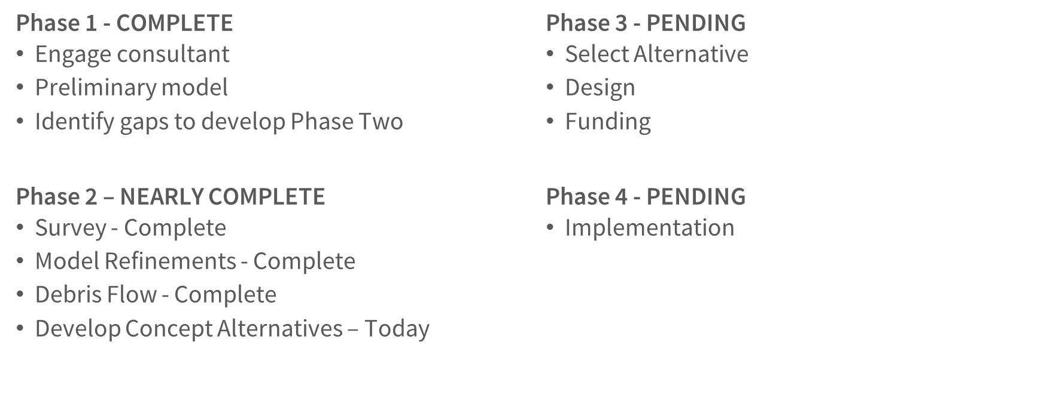
Where things stand

Slide 4
Phase 1 recap
Conclusions
Determined that Existing Infrastructure is Undersized
Channel Capacity is Lacking
Recommendations
Additional Survey - Complete
Model Refinements - Complete
Look at Debris Flow - Complete
Develop Concept Alternatives - Today

Slide 5
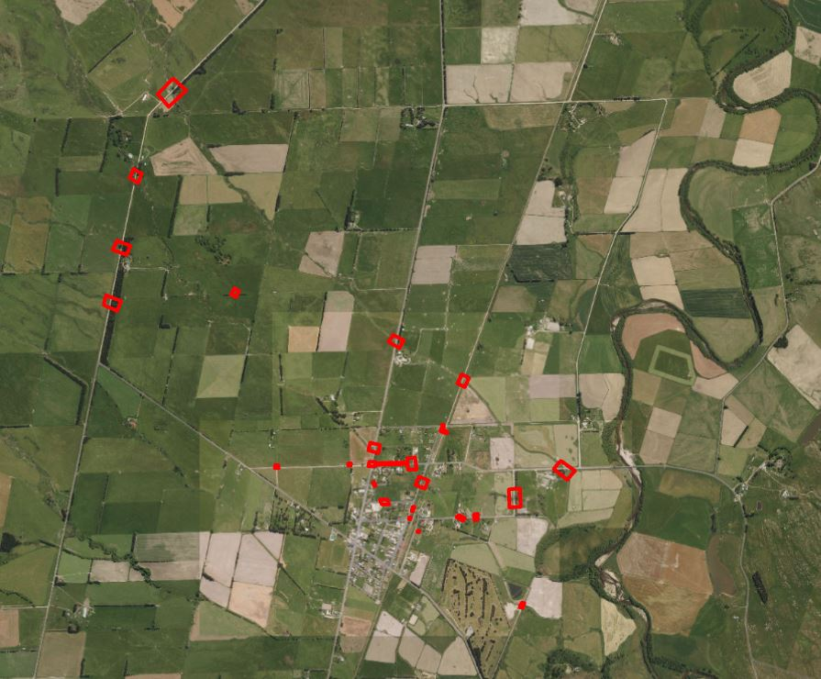
Phase 2
Survey

Slide 6
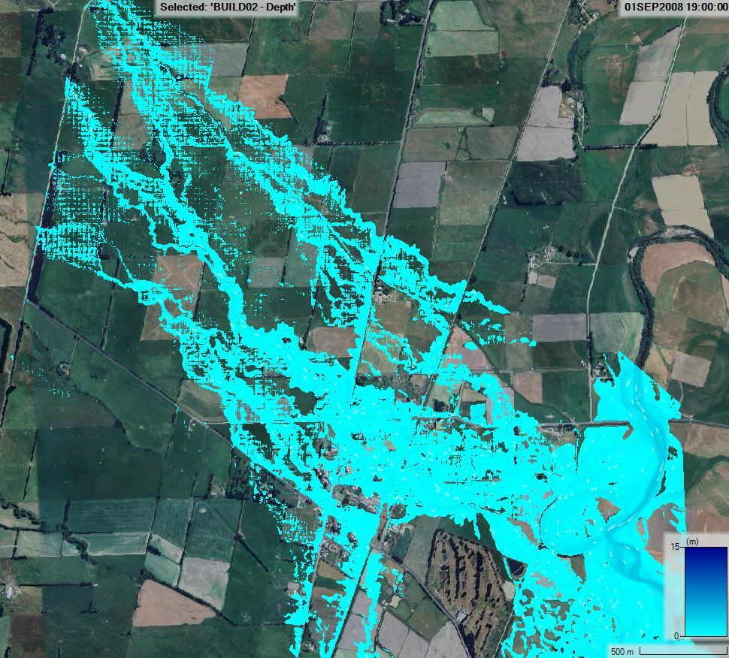
Phase 2
Model Refinements

Slide 7
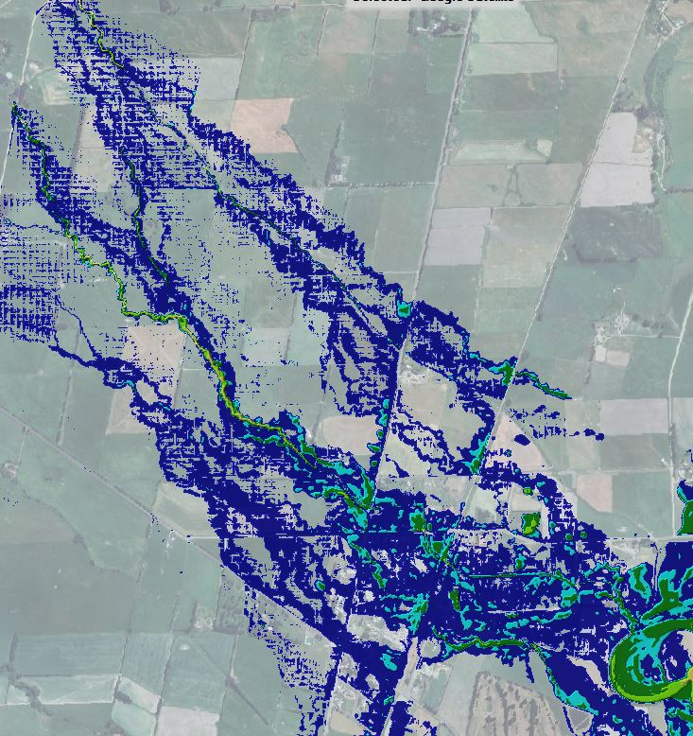
Risk is low

Slide 8
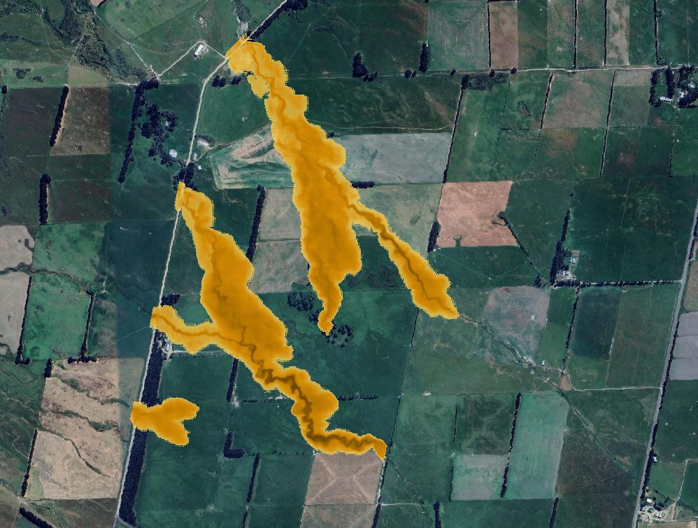
Debris flow

Slide 9
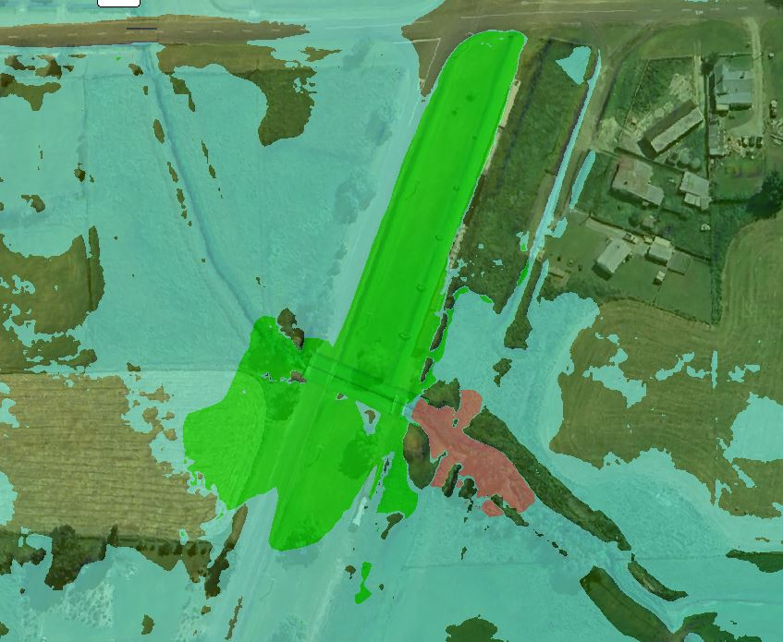
Rail and Tawe St Structure Enlargement
Enlarging the RR and Tawe St. Structures Alone Made Almost No Difference

Slide 10
Phase 2
What we learned
Phase 2 confirmed Phase 1 findings
Existing infrastructure is undersized
Upstream channel capacity is lacking
Discharge forced into other channels
Stormwater system not designed for purpose
Debris flow not a major concern
Risk is low
Solutions are not readily apparent

Slide 11
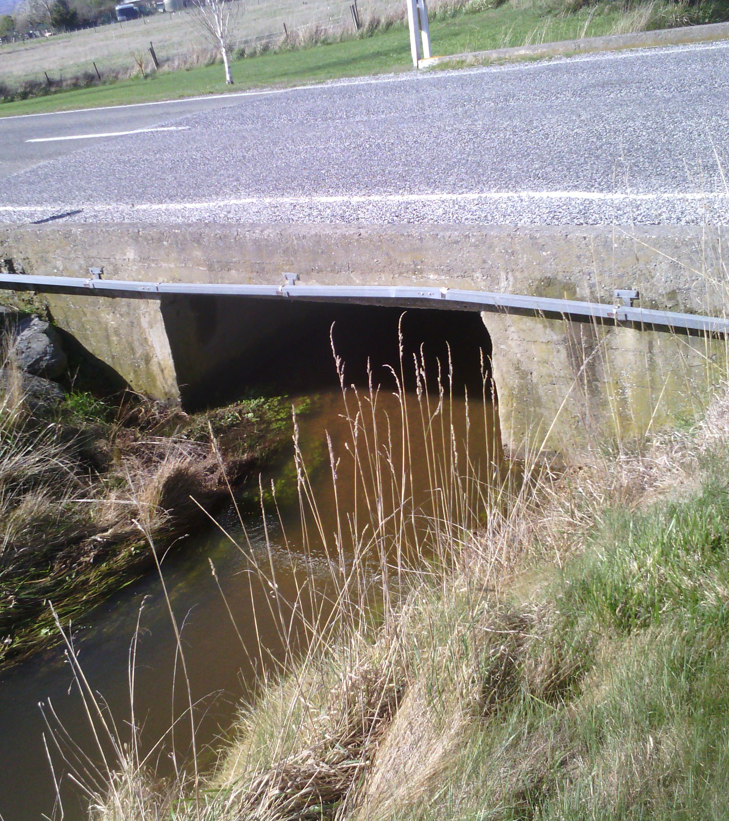
Phase 2
What are the options?
Key considerations
Enlarging structures could prove difficult
limited opportunity to raise structures
Solutions likely need to extend upstream
Larger structures without channel modification is minimally effective

Slide 12
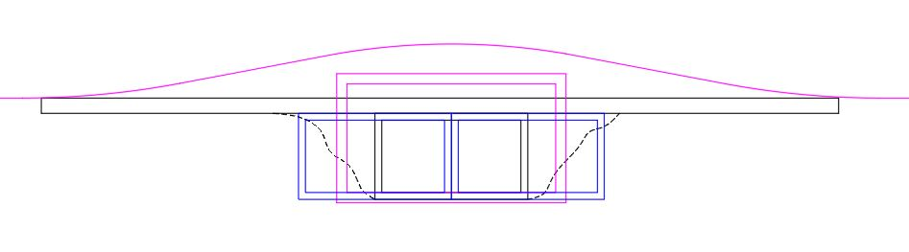
Profile

Slide 13
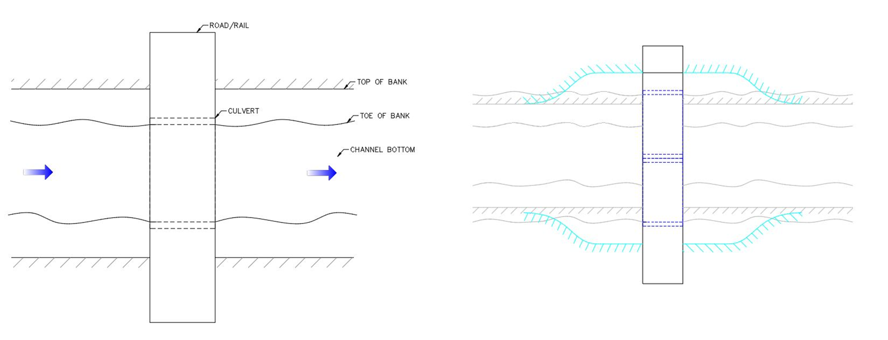
Plan

Slide 14
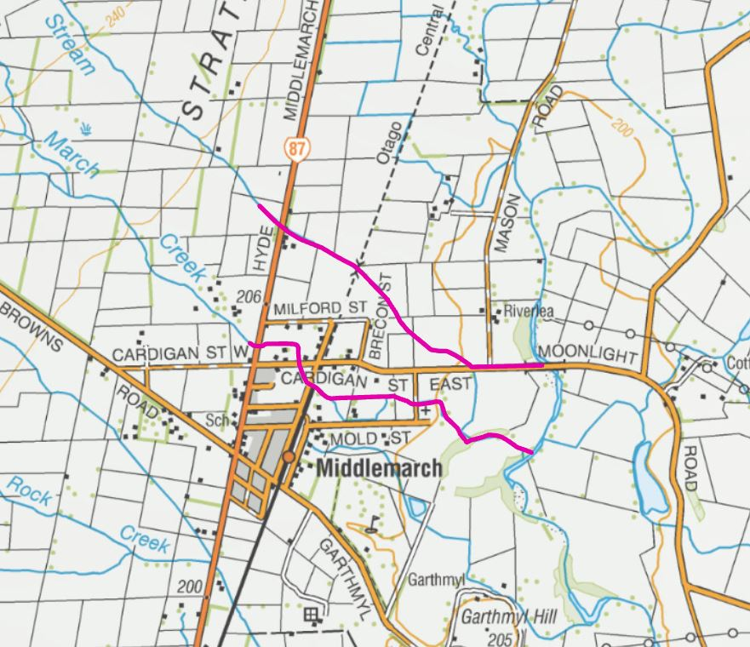
Channel improvements
Cost: $-$$$

Slide 15
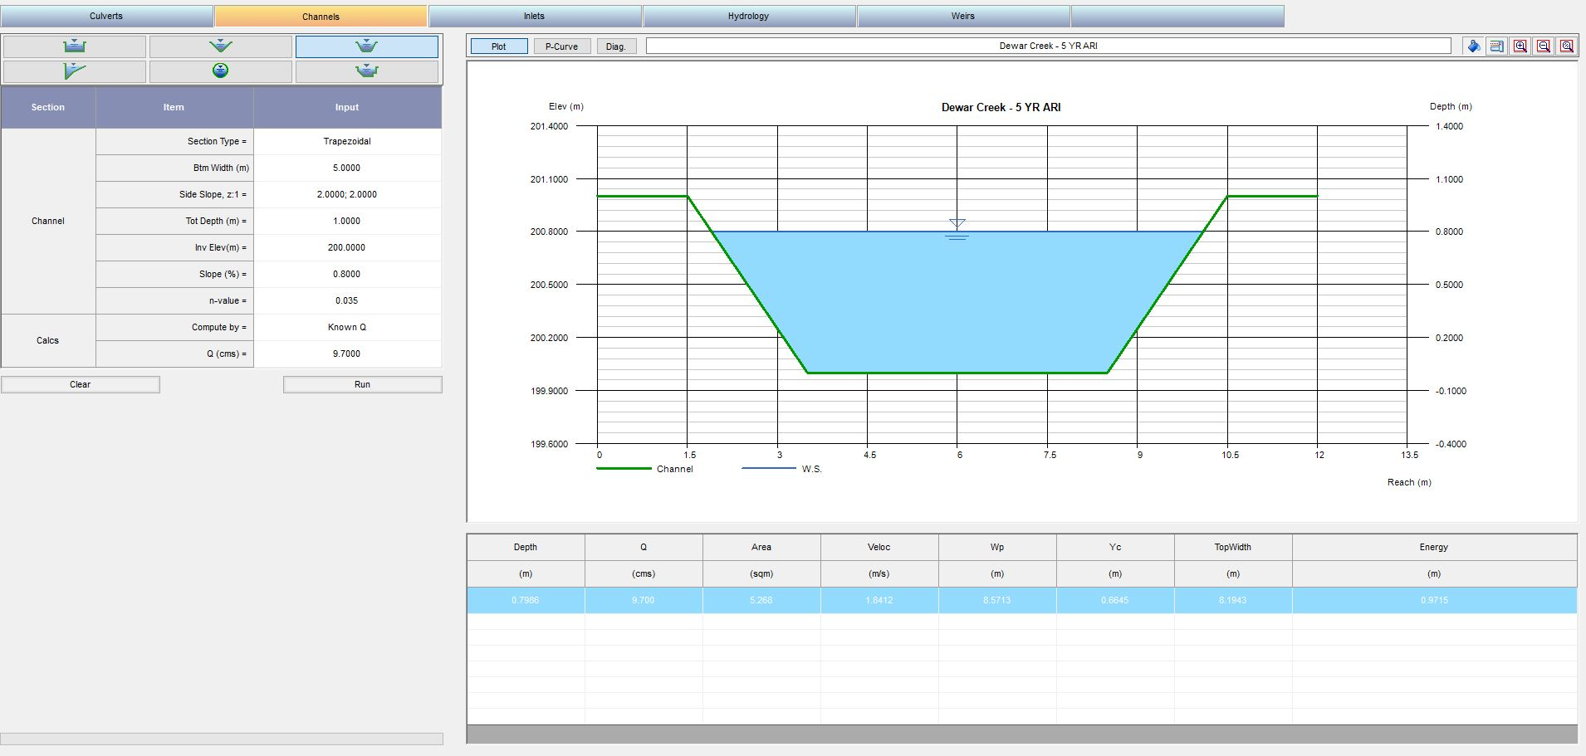
Rough estimates
Let's Assume:
Trapezoidal Channel
Grass Lined (n=.035)
2:1 Side Slopes
Slope: .8% - Average
Max Depth 1m (.2m freeboard)
How Wide Would We Need?

Slide 16
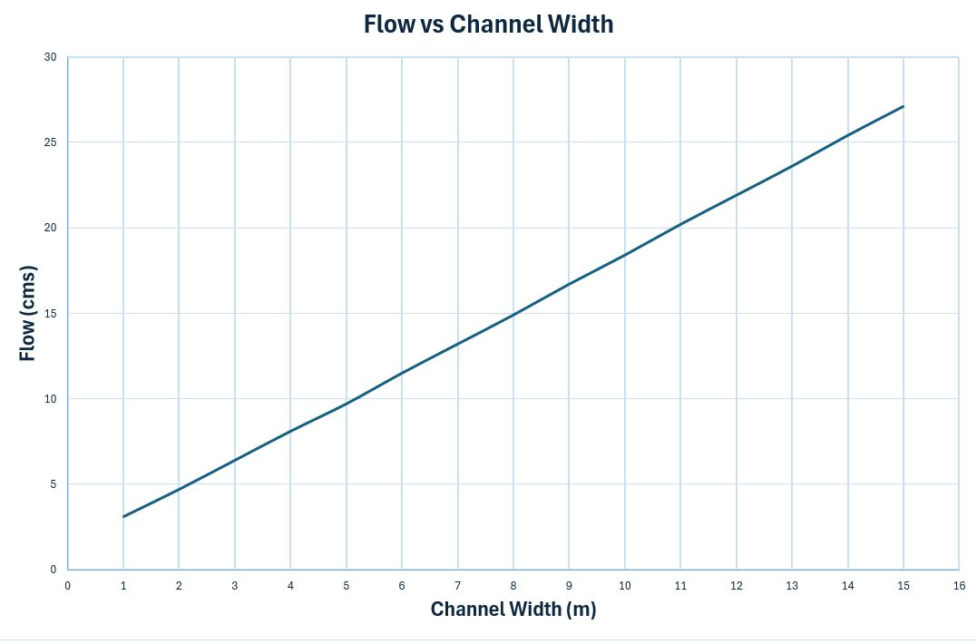
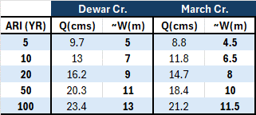
Rough estimates
How does this compare with the observation?

Slide 17
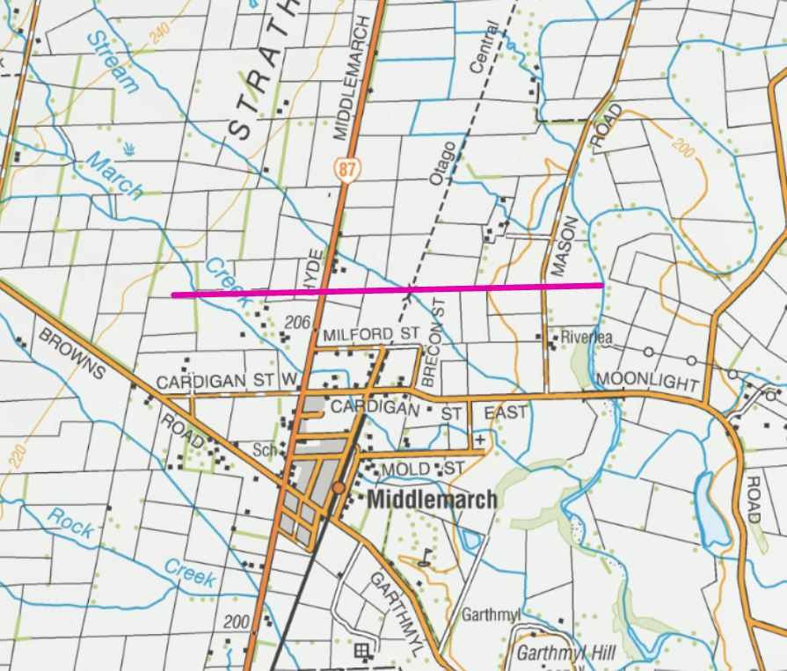
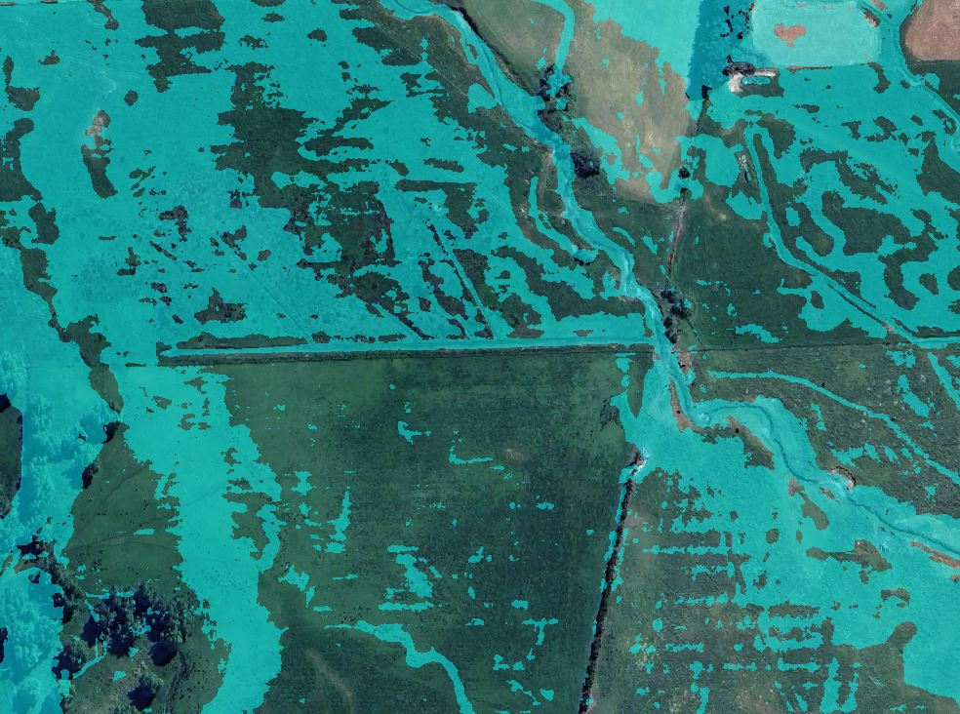
Diversion channel
Cost: $$$
Water begins to overtop lower banks

Slide 18
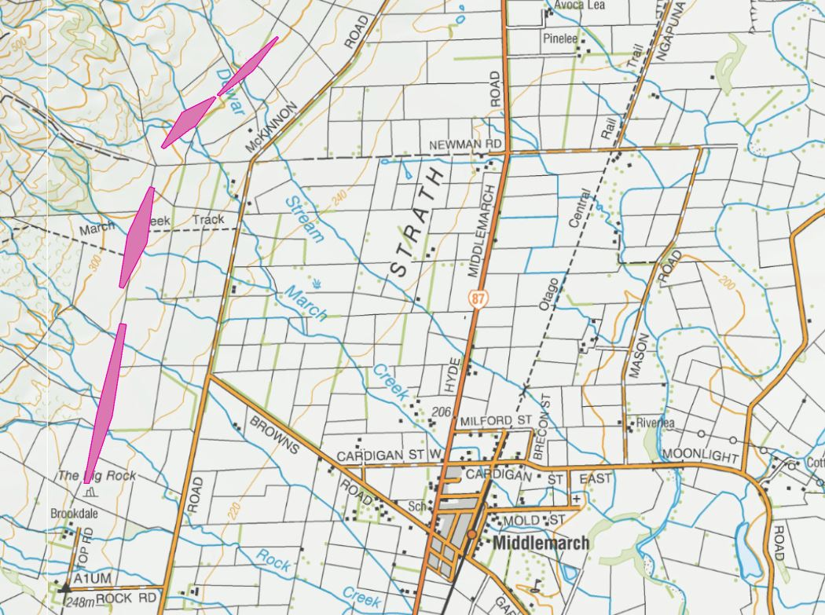
Debris Basins
Cost: $$$$

Slide 19
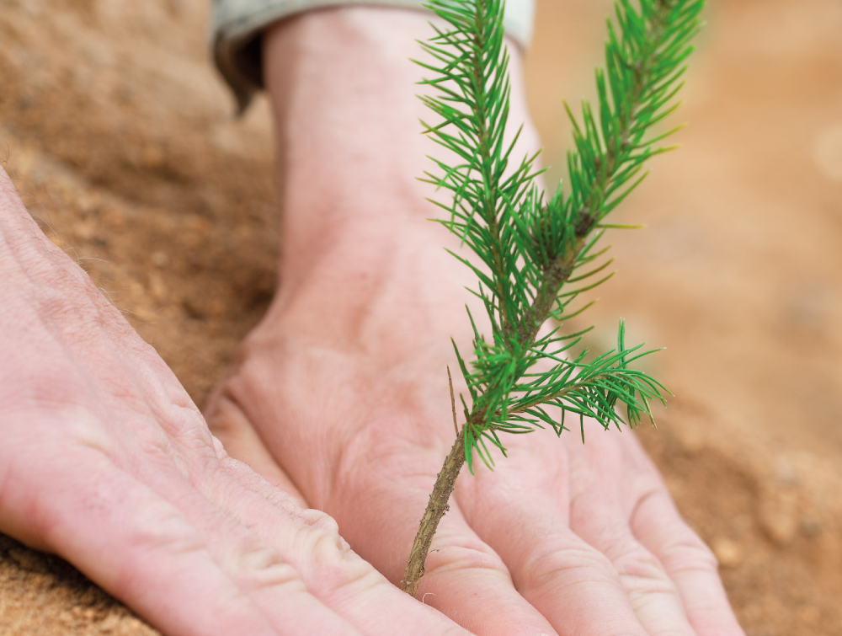
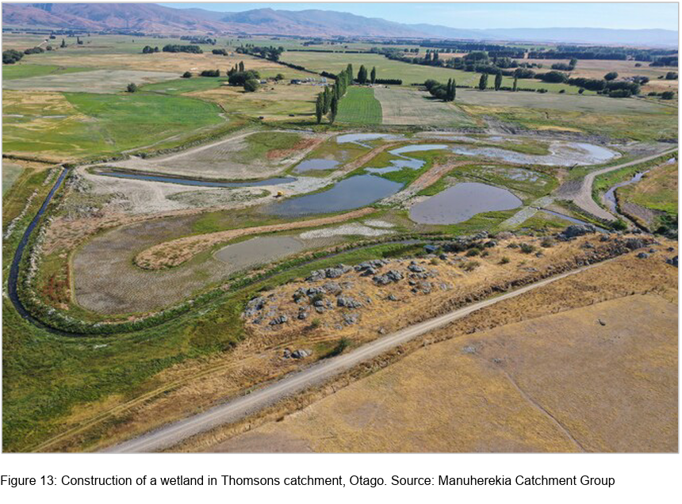
Other?
Cost: $$-$$$$
Reforestation?
Wetlands?

Slide 20
Summary
Multiple Issues Exist
Undersized Structures
Limited Channel Capacity
Risk is Generally Low
No Low Hanging Fruit
Solution is Likely to be a Large Effort
Based on This -Do We Proceed to Phase 3?

Slide 21
Next Steps
Discussion – Phase 3
Develop Alternatives?
Funding?
Timeline?

