Slide 1
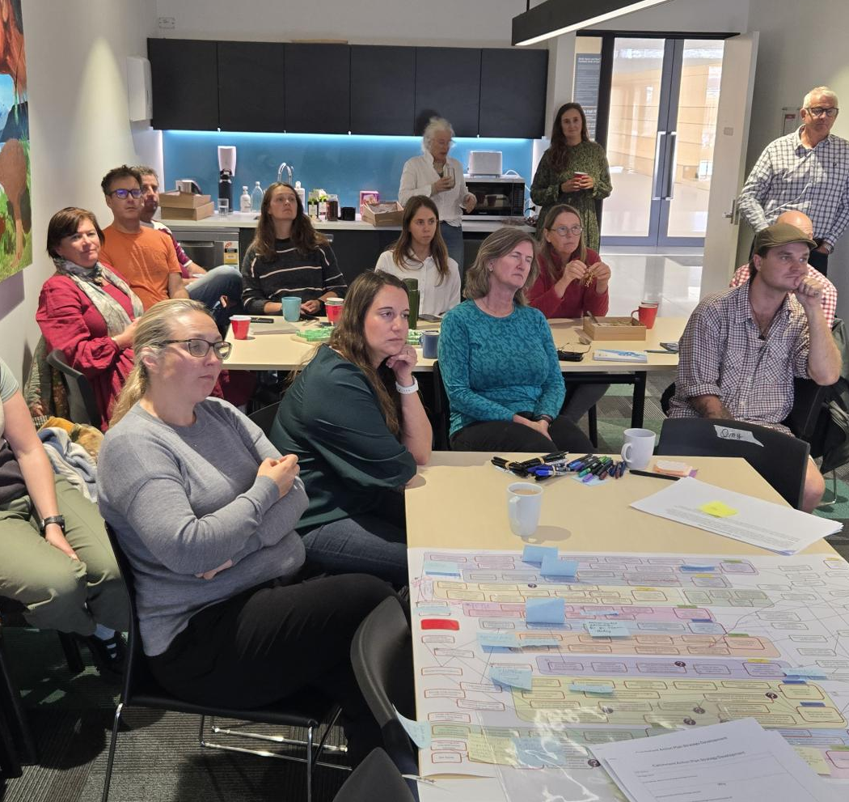
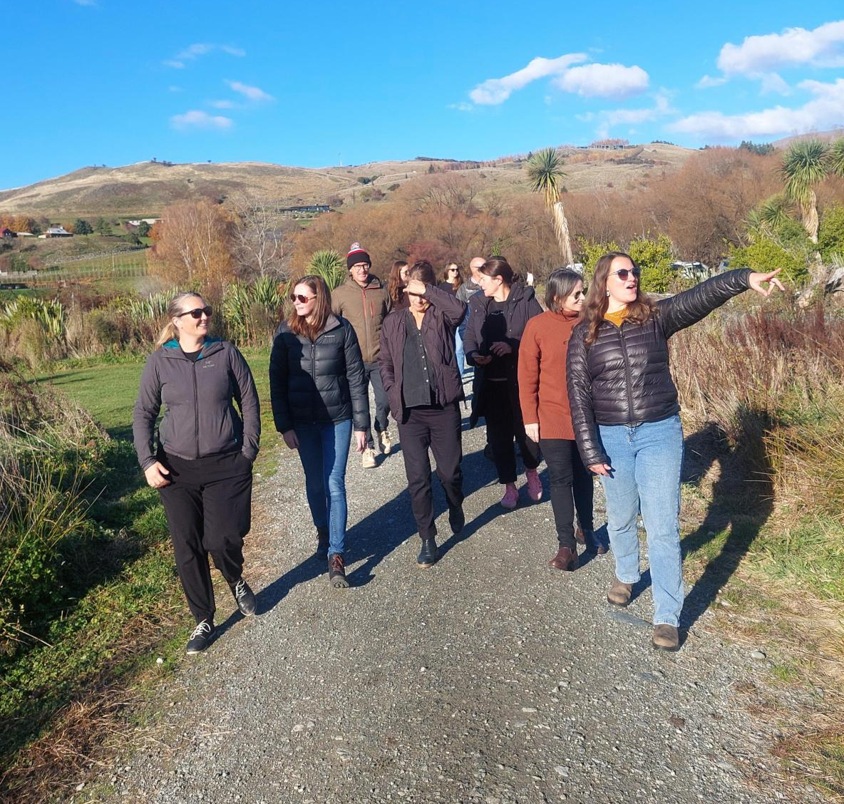
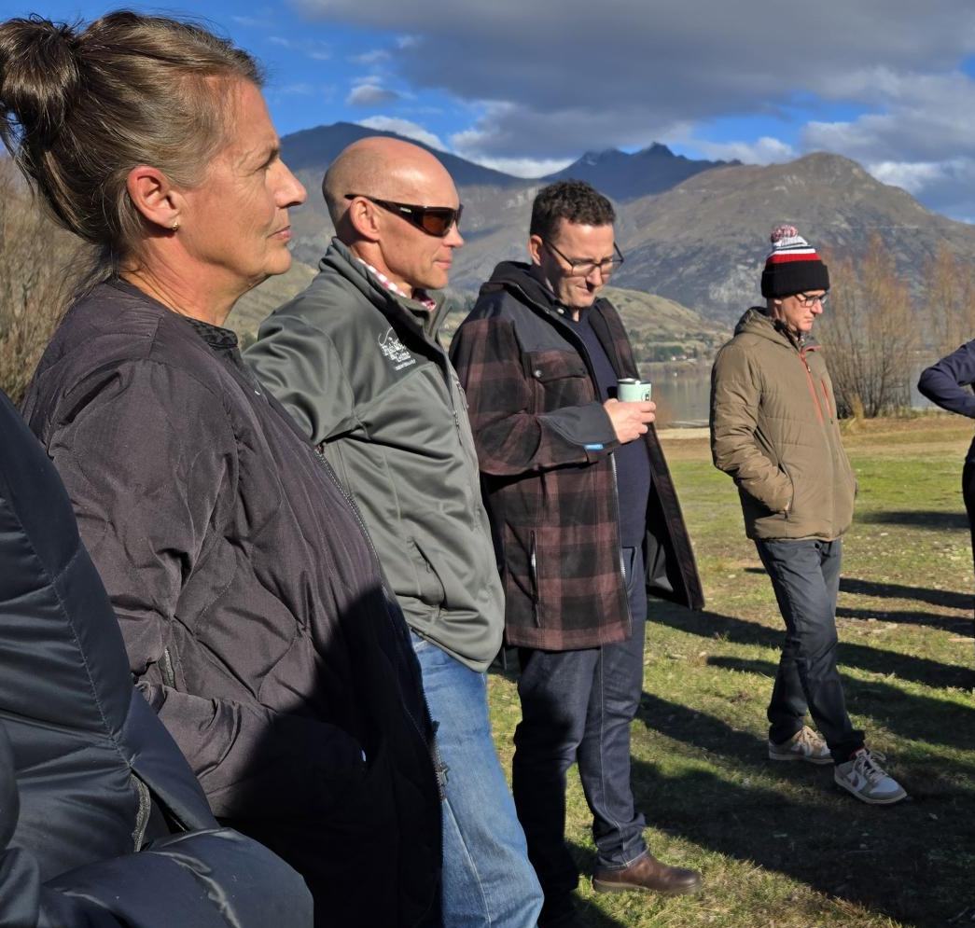
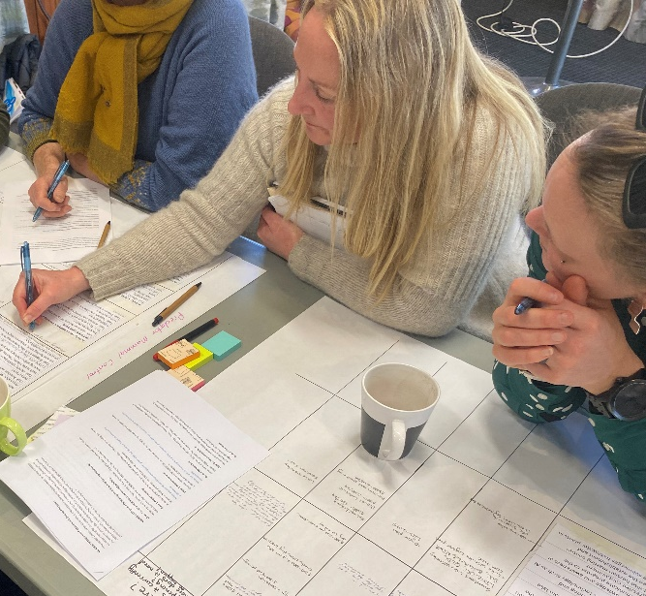
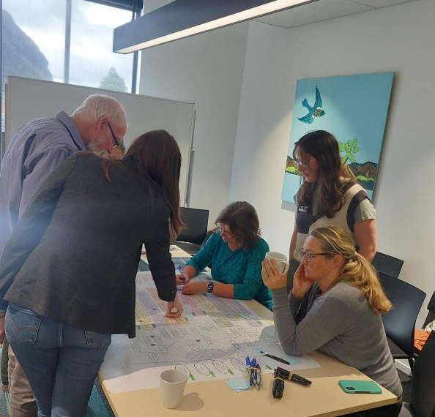
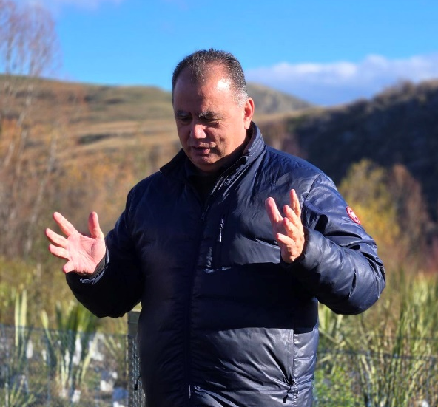
Catchment Action Plan 2025 – 2035
Upper Lakes Integrated Catchment Group

Slide 2
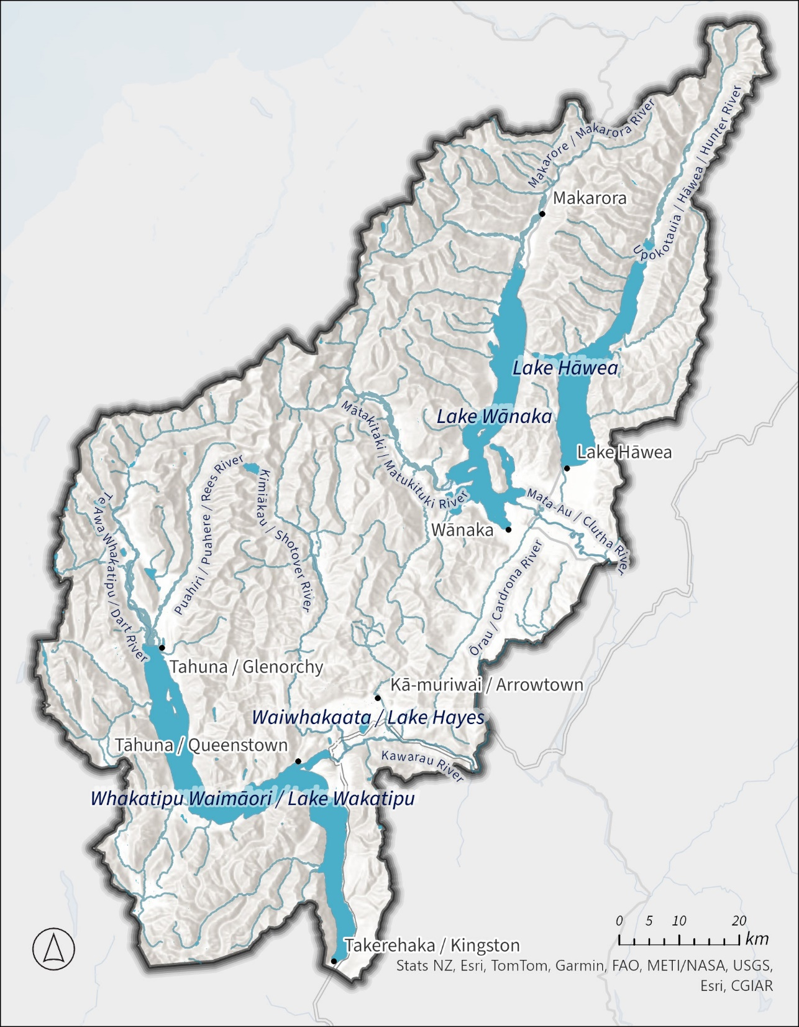
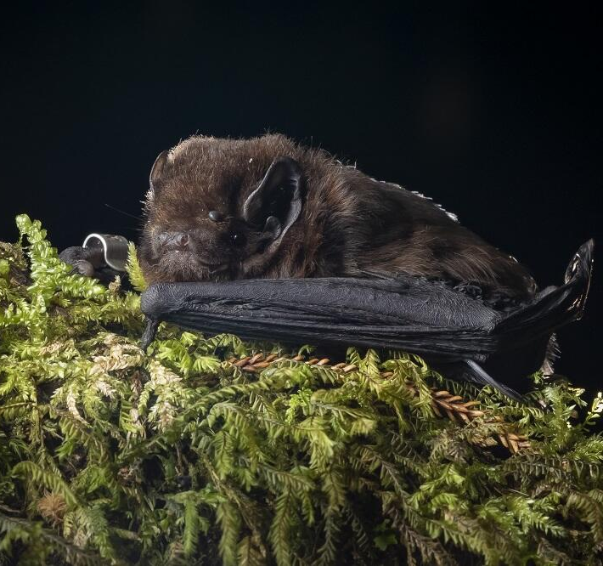
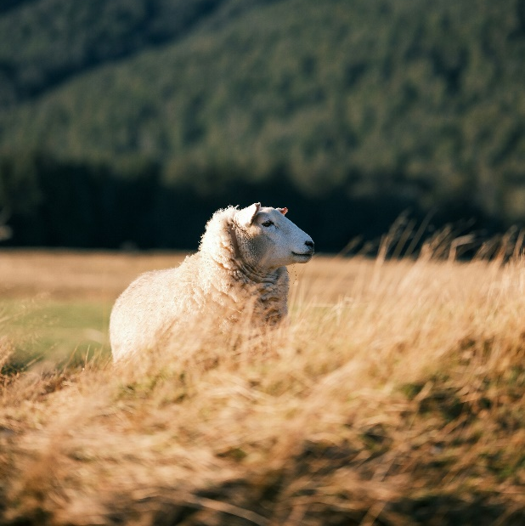
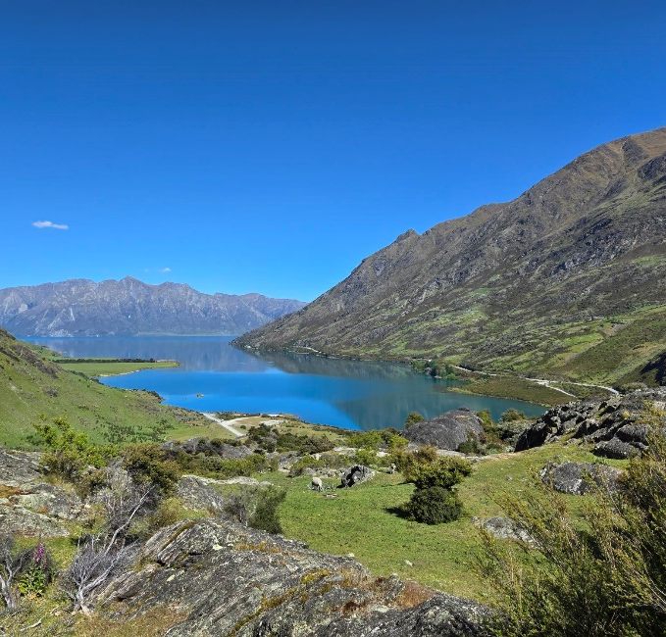
Our vision
“It’s 2075 in the Upper Lakes. Takahē cross paths with hikers, bird colonies nest undisturbed on braided river gravels, and pekapeka tou-roa (native bats) glide through ancient beech canopies.
Behind them, wetlands and bush weave through sustainable, thriving farms renowned for their food and fiber, while towns are cooled and connected by streams, wetlands, and green space.
Mana whenua connection to place and taoka (treasures) is flourishing, mātauraka (knowledge) is strong and rakatirataka (authority) evident.”

Slide 3
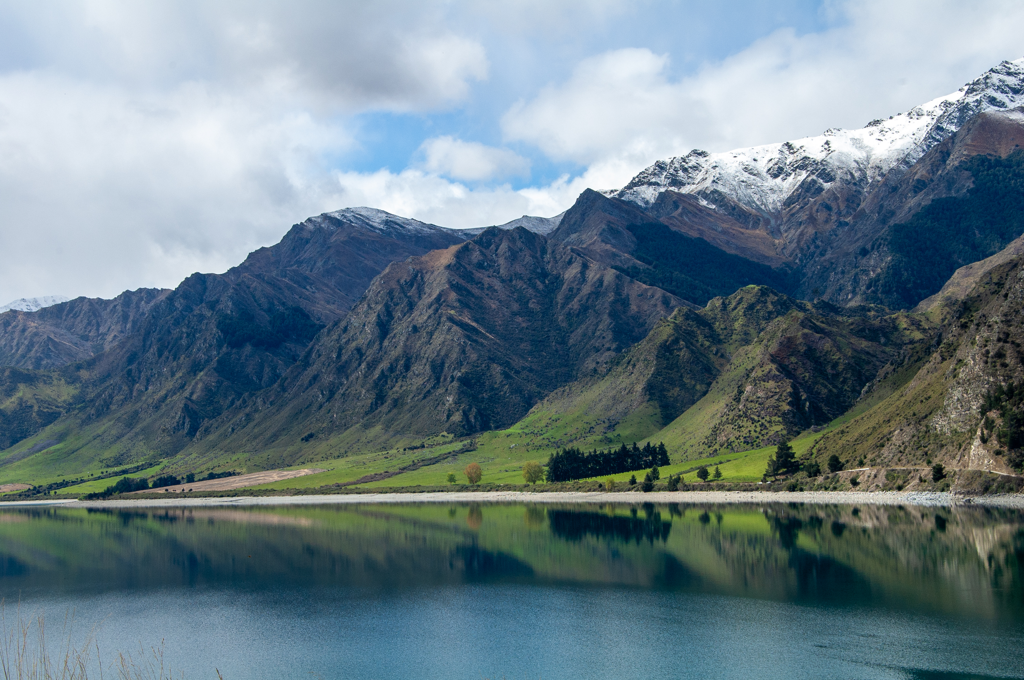
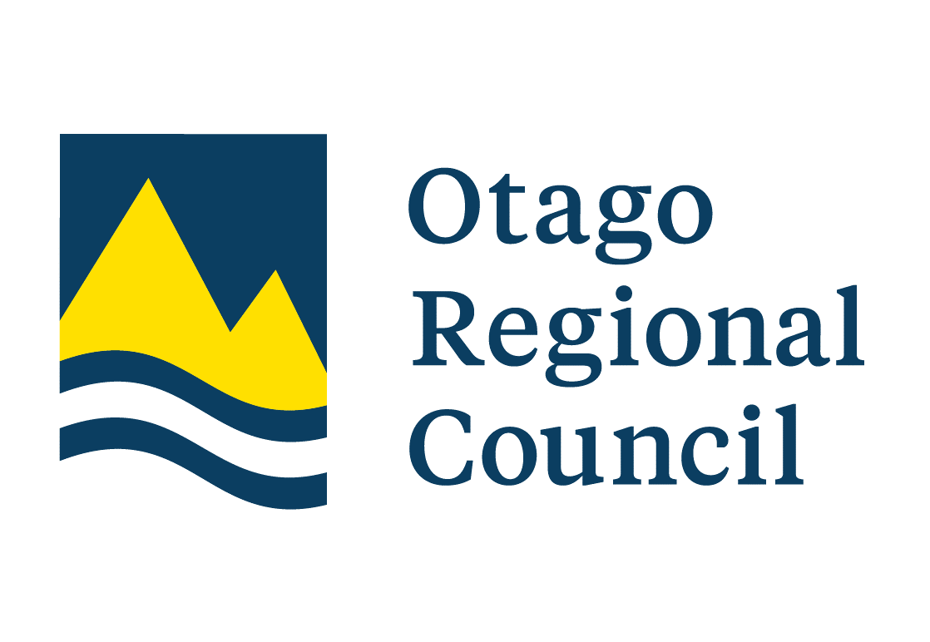
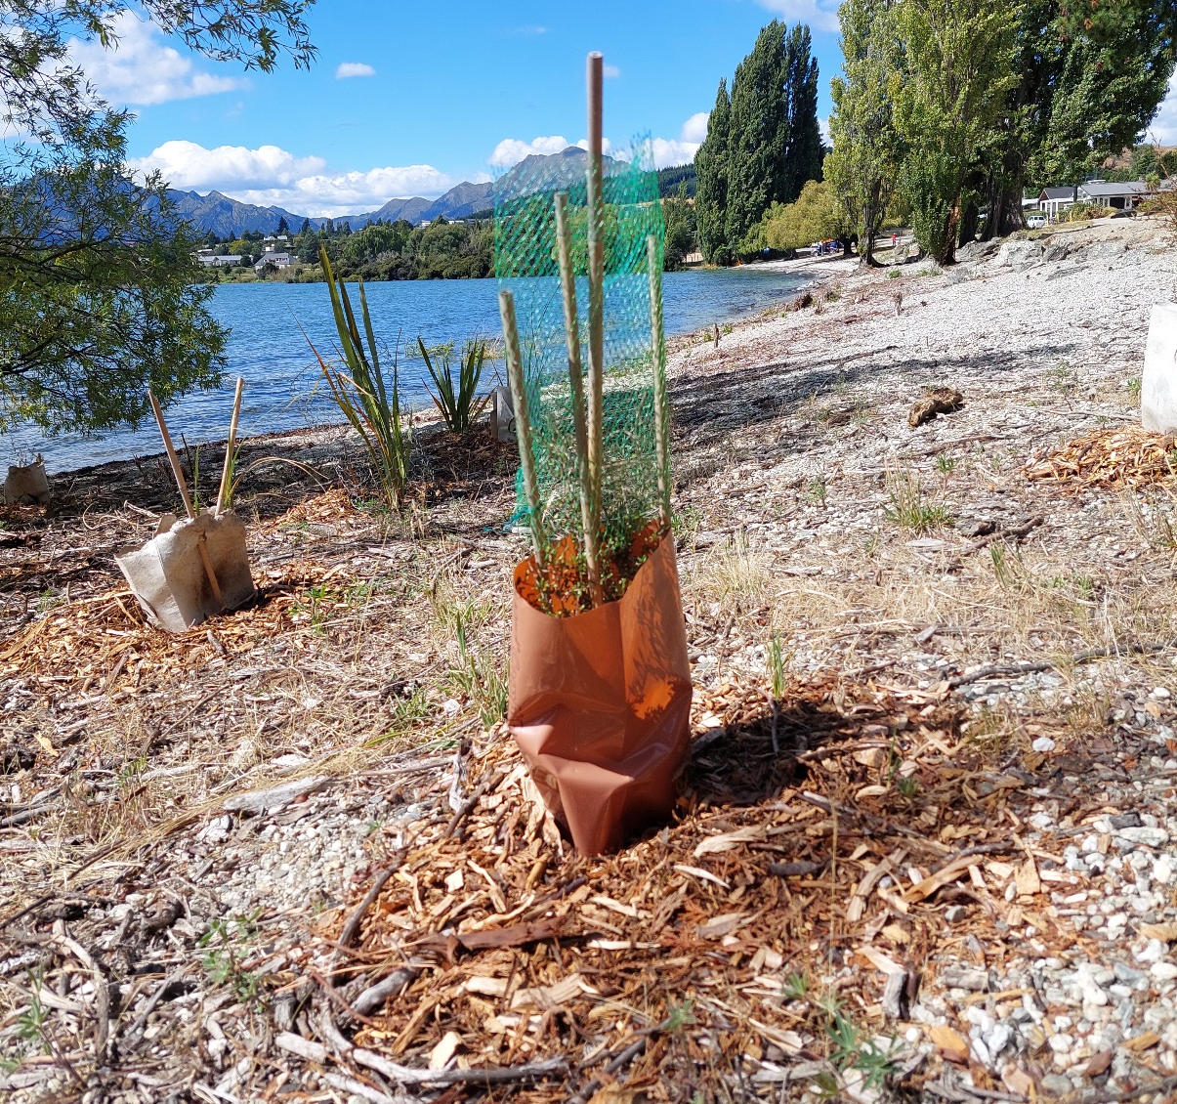
Action Plan
Develop a long-term and diverse framework that sustains funding that will support actions
Increase science, research and knowledge sharing for the community
Strengthen our mana whenua partnership in the Upper Lakes area
Improve environmental conditions for mahika kai and enable safe use
Control introduced predator mammals
Assist tuna kuwharuwharu (longfin eel) and kanakana (lamprey) migration, in partnership with mana whenua
Protect and enhance galaxiid habitats
Control wilding conifers (pines and firs) and terrestrial weeds
Protect, restore and enhance native vegetation
Protect, restore and enhance wetlands
Reduce contaminants from stormwater and wastewater
Reduce contaminant losses from land use
Reinforce freshwater biosecurity in deepwater lakes
More detail on the Upper Lakes Hub
upper-lakes-orcnz.hub.arcgis.com

Slide 4


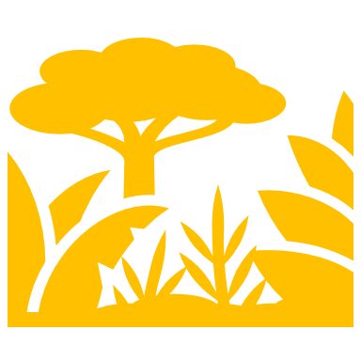
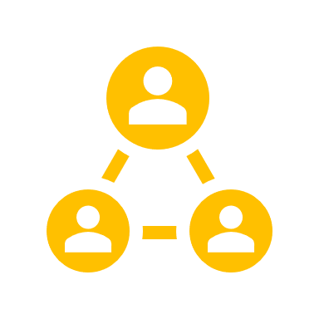
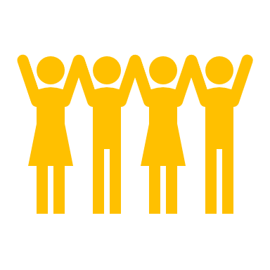
Where to from here…
Establish an Upper Lakes CAP Governance Group with clear terms of reference. Work with groups and agencies to lead projects on the ground.
Delivery of actions will not rest with the governance group alone but with conservation and catchment groups, mana whenua, agencies (including ORC), landholders, and industry, who will lead projects on the ground.
Practical support will come from ORC work programmes and CAP delivery coordination, ensuring alignment with regional priorities and technical expertise.
Shared responsibility and resourcing model reflects the collective impact approach at the heart of the CAP, where success depends on many hands working together.

Slide 5
Document download and interactive components are on the Upper Lakes GIS hub
upper-lakes-orcnz.hub.arcgis.com
(or search “Upper Lakes Hub”)

