Slide 1
Draft Land & Water Regional Plan
Environmental Science and Policy Committee briefing
27 March 2024

Slide 2
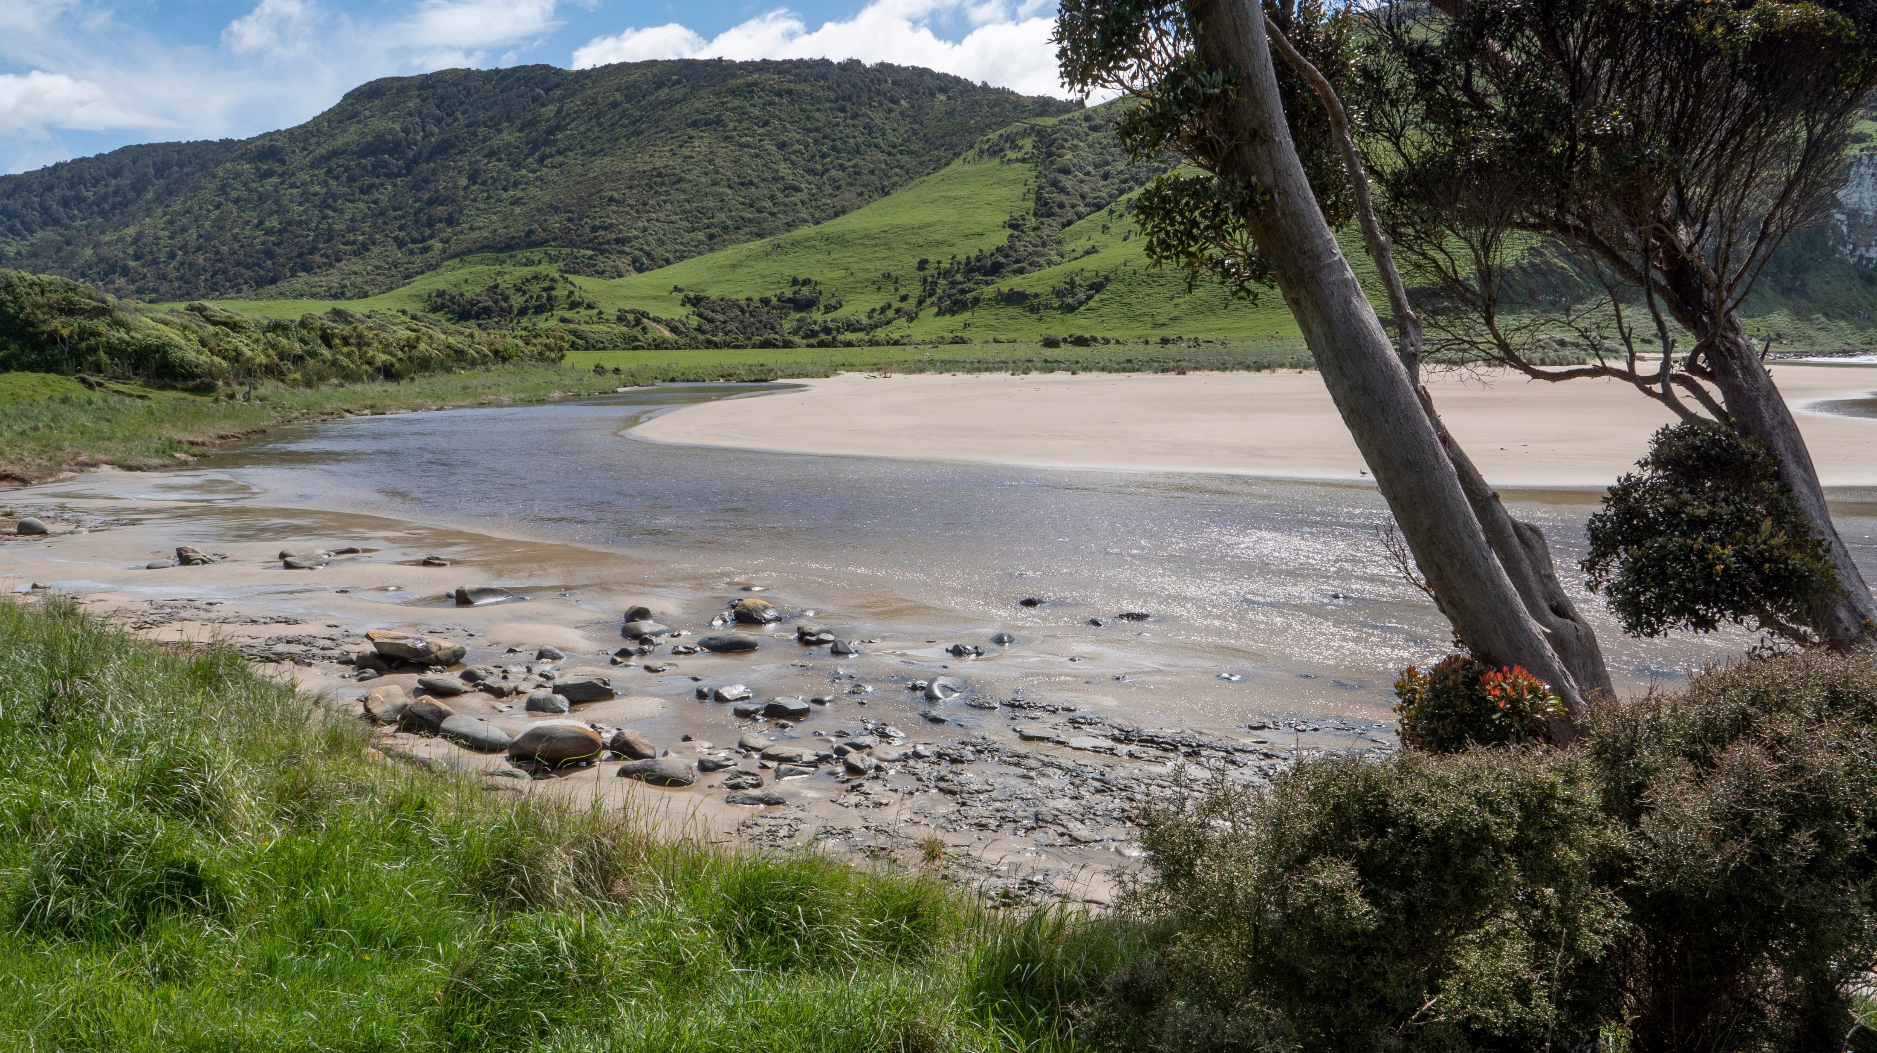
AGENDA
Overview of the key issues raised in feedback and internal review
Overview of feedback received
Substantial changes recommended or council input requested

Slide 3
Topics
GENERAL - HYDRO
EFL Chapter (Water quantity - Environmental flows and levels)
DAM Chapter (Damming and Diversion)
FMU chapters

Slide 4
GENERAL – HYDRO-ELECRICITY GENERATION
Key themes in feedback received
General support for the plan’s approach to managing Hydro/REG.
Some specific comments
Need for “straightforward” consenting pathway for ongoing maintenance for Otago’s nationally and regionally significant schemes (e.g. Clutha, Waipōuri) ​
Some parties considered it was unclear which provisions apply to REG. ​
Some provisions could be amended to better provide for small scale REG. ​
Staff are considering a range of minor/technical amendments to address these.
Notes:
REG- recommend new bespoke controlled activity rule for maintenance of Clutha Hydro Scheme, and amend policy to provide for new in stream damming for small scale hydro if it is primary purpose of the dam.

Slide 5
GENERAL – HYDRO-ELECRICITY GENERATION
Substantial amendments OR guidance requested
New controlled activity rule for maintenance works on the Clutha, Waipōuri, Deep Stream, and Paerau/Patearoa schemes, excluding the overall taking, use, damming, and discharge of water.

Slide 6
ENVIRONMENTAL FLOW & LEVELS (& other water quantity related matters)
Key themes in feedback received
Generally supportive of approach to over-allocation
Some parties request stricter rules in over-allocated catchments
Others request more time to phase out over-allocation
Minimum flows and take limits - Some opposition to:
Take limits based on consented allocation
Default take limits that apply in some catchments (too conservative and not effects based)
Ability to set alternative minimum or site-specific flows.
B Block flows & take limit method.
Notes:
Over-allocation – some suggest that it should be prohibited to go over allocation limits – a non-complying pathway is provided to allow for consent renewals, all other takes prohibited
B Block take limits and flows- now proposed to calculate these for rivers with flow recorders, and include in plan. But policy does allow flexibility to propose alternative ones in consent process.
PA rules – concerns about permitted volumes being too small for animal drinking water, concern that domestic supply and stockwater subject to minimum flows, so not available at all times.
Other parties supportive of the rules and note that permitted takes can involve substantial amounts.

Slide 7
ENVIRONMENTAL FLOW & LEVELS (& other water quantity related matters)
Key themes in feedback received
Permitted activity rules
Concern rules for domestic use and animal drinking water too strict.
Permit takes for other uses (e.g. horticultural root stock, biosecurity).
Efficiency
Consider at a broader scale
Concern about unintended consequences
Concern that efficiency gains will result in insufficient water in dry years.
Notes:
Actual use method = based on 10 years
Difficult to consider efficiency at broader scale.

Slide 8
ENVIRONMENTAL FLOW & LEVELS (& other water quantity related matters)
Key themes in feedback received
Issues raised on env. flows/levels & limits for specific water bodies
Concern about Clutha Mata-au minimum flow (internal feedback)
Concern about impacts of environmental levels for controlled lakes on existing REG
Concern about the minimum flow and take limit for Waikouaiti River

Slide 9
ENVIRONMENTAL FLOW & LEVELS (& other water quantity related matters)
Substantial amendments OR guidance requested
Recommendation to amend the environmental flow and take limit for Waikouaiti River in the draft LWRP
Set take limit based on actual use
Set minimum flow based on existing ‘residual flows’

Slide 10
DAMMING AND DIVERSION
Key themes in feedback received
New in-stream damming
Some parties consider the policy approach too stringent; others consider it too lenient.
Approach responds to strong direction in the NPSFM (avoid loss and extent of river values) and mana whenua aspirations.
Taking of water into in-stream dams
Concern about requirement to measure or model the impoundment volume and dam inflows and outflows
Fish spawning and taoka species
Need greater recognition of fish spawning in policy and rules.
Request to reference taoka species in policies.

Slide 11
DAMMING AND DIVERSION
Key themes in feedback received
Activity status for “drop-out” rules
Where permitted activities are unable to be met, the “drop-out” rules should be more lenient than discretionary.
Diversions
Clarify what effects are being managed by the diversion rules.
Amend the conditions to control the scale, timing and relevant adverse effects.

Slide 12
FMU and rohe specific provisions
Key themes in feedback received
Environmental outcomes/objectives
General support for the environmental outcomes
Some parties request reordering, inclusion of new environmental outcomes (sometimes FMU specific), and amendments to the wording
Concern re the policies in North Otago FMU Chapter
FMU & rohe specific rules
Oppose activity status
Oppose some of the setbacks
Notes:
Some parties request reordering, inclusion of new objectives in specific FMUs (e.g. food production and insurtiela and commercial activity in Catlins
, Amendment to the wording (e.g. new objective for commercial/industrial and trade

Slide 13
FMU and rohe specific provisions
Key themes in feedback received
Some request limits for groundwater
Target attribute states/alternative criteria
Some support
Some TAS are too low
TAS for more locations, values and water body types (e.g. wetlands)
Disconnect between values and TAS/alternative criteria
Some request more monitoring sites
Notes:
Some parties request reordering, inclusion of new objectives in specific FMUs (e.g. food production and insurtiela and commercial activity in Catlins
, Amendment to the wording (e.g. new objective for commercial/industrial and trade

